Slide 1


Introduction (1/2)
Information for screen reader users: More complex slides and images are described in the notes for the respective slide
Americans with Disabilities Act
(ADA)
European Accessibility Act
(EAA)
Have the purpose to support people with disabilities
Are a challenge for website owners who need to meet these compliances

Slide 2
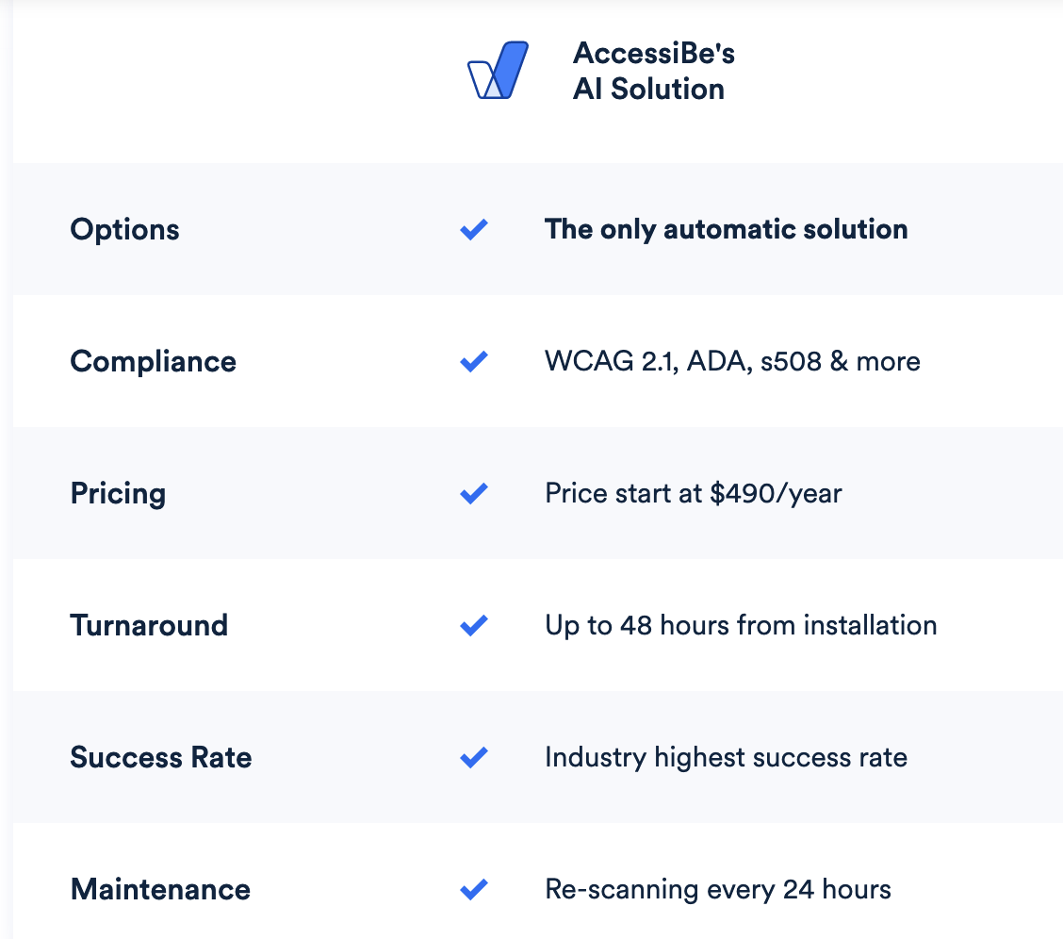
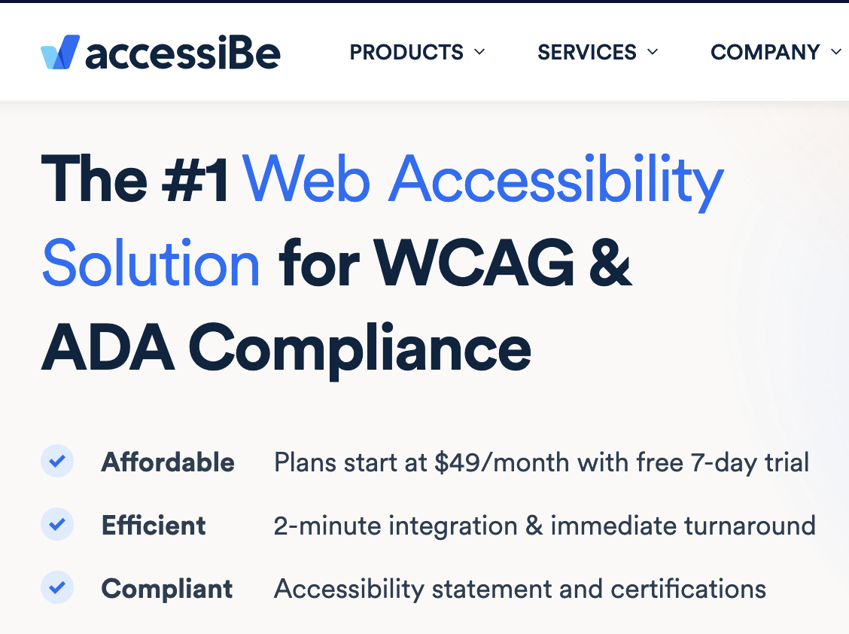
Introduction (2/2)
Source: https://accessibe.com/ | Taken: 30.06.22
Source: https://accessibe.com/accesswidget/competition | Taken: 30.06.22

Slide 3

Overlay tools as a support for accessible websites –
possibilities and limitations
Niklas Egger,
Gottfried Zimmermann and Christophe Strobbe
Hochschule der Medien, Stuttgart, Germany
Slides for ICCHP-AAATE 2022 | Thursday, 14th July

Slide 4
Methods
Literature research
Various articles, blog entries and other internet sources
A total of nine providers were elicited
Three overlay tools were analysed in detail
A real website with failures was cloned and used as a test environment
Further failures were added manually, in total 29 of 92 test steps of the BIK BITV test
Seven metrics were defined for the evaluation and comparison
Based on the providers' promises and the WCAG requirements
Weighted in a survey of 17 participants

Slide 5
Overlay tools - Definition
No consistent definition of the term "overlay tool"
„Overlays are a broad term for technologies that aim to improve the accessibility of a website. They apply third-party source code (typically JavaScript) to make improvements to the front-end code of the website. “ [1]
Beyond the implementation, the source code remains unchanged [2]
Important to distinguish between client/ website specific overlay tools and overlay tools which, according to vendor claims, work on all websites [3].

Slide 6
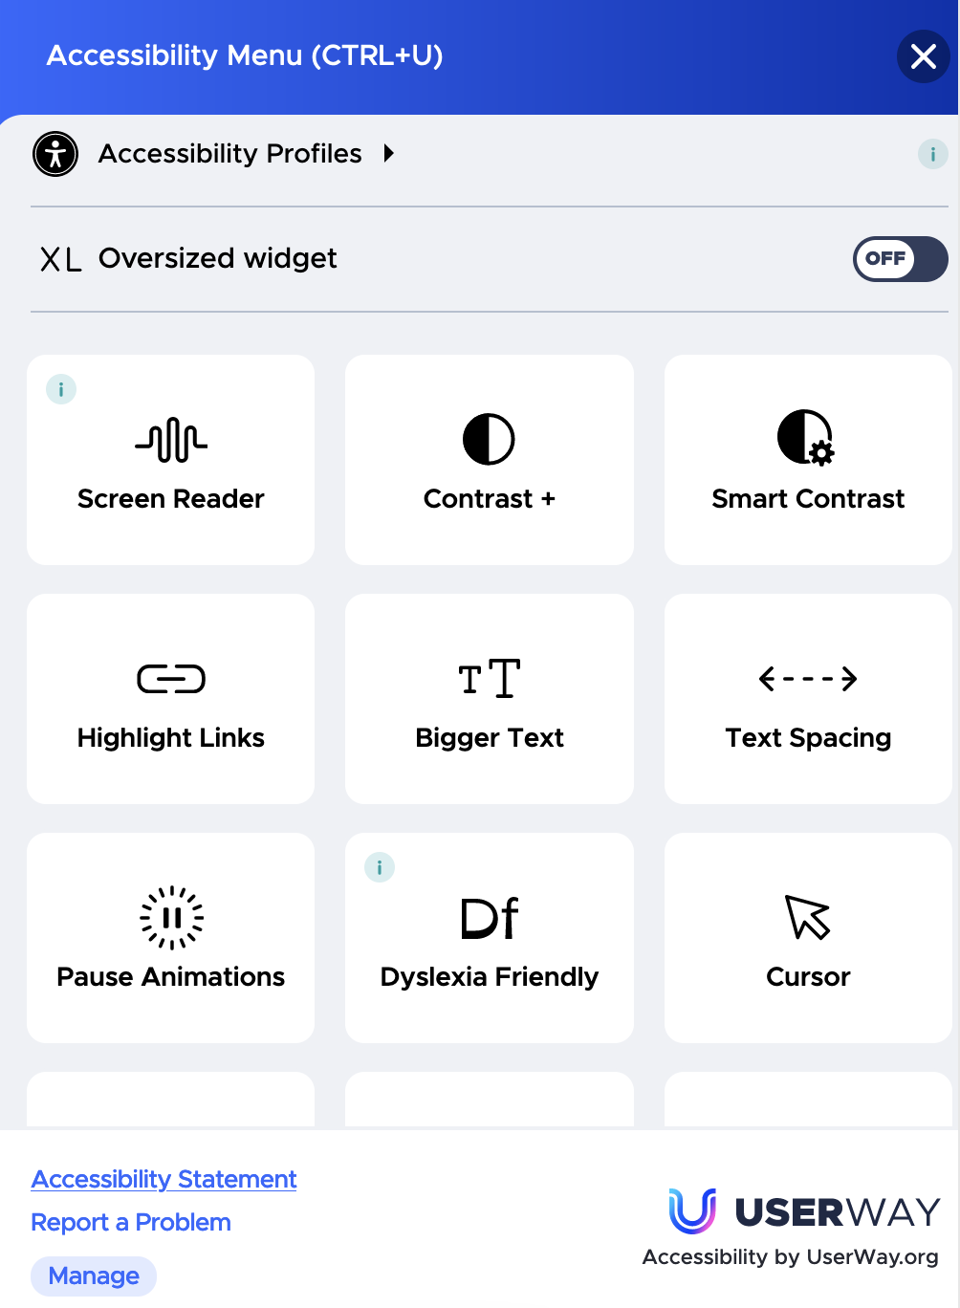
Overlay tools - Toolbar
Overlay tools often add toolbars to the website
They can include settings for the appearance of the website as well as other features like e.g., a Screen Reader
Source: Accessibility Menu from UserWay
Taken: 06.07.22

Slide 7
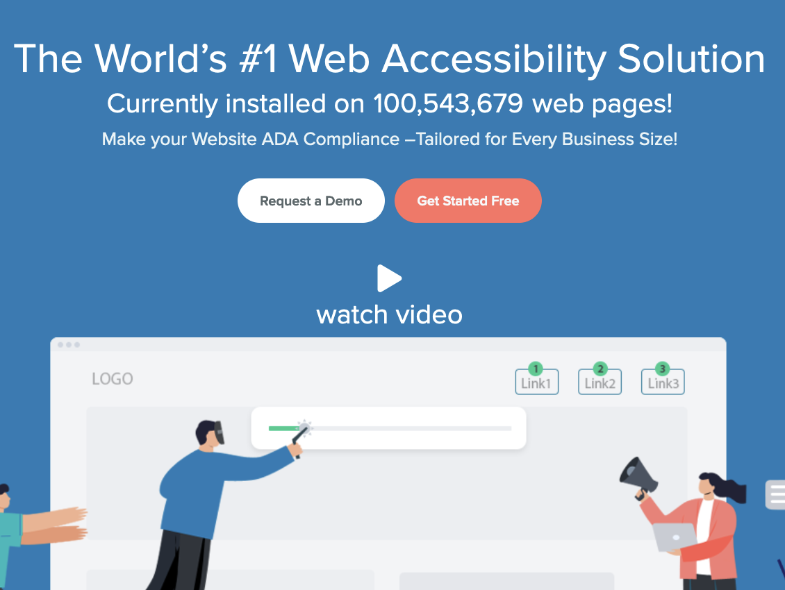
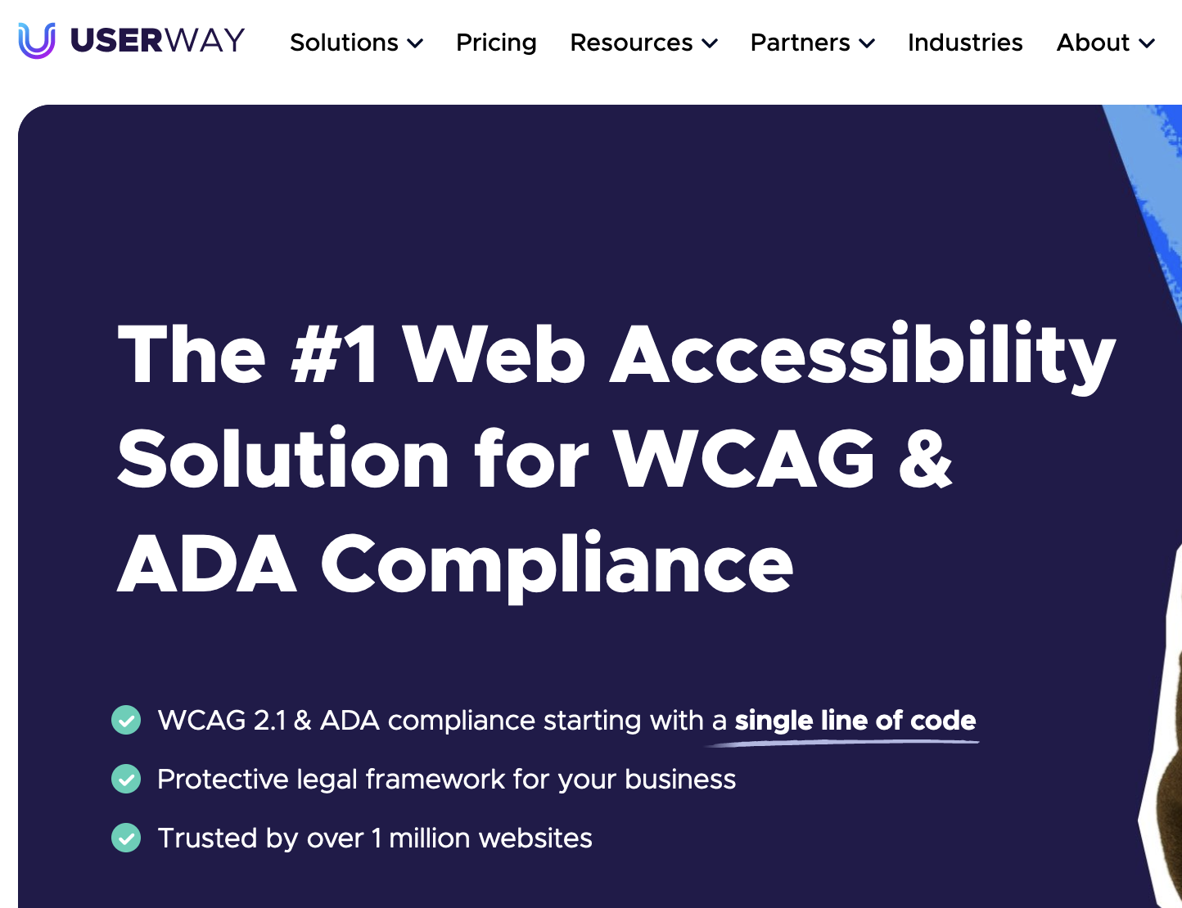
Overlay tools analysed for this study
accessiBe
EqualWeb
UserWay
Source: https://accessibe.com/
Taken: 30.06.22
Source: https://www.equalweb.com/
Taken: 01.07.22
Source: https://userway.org/
Taken: 01.07.22

Slide 8
Subscriptions
accessiBe
EqualWeb
UserWay
„Small“ of the „Auto Accessibility Plans“
39$ / Month
„Standard“
49$ / Month
„Small Business“
49$ / Month
Additional paid services and features were not taken into account

Slide 9
Parameters for the analysis
A replication of the unithekle.de website was used as the test environment
The website is not too technologically outdated and at the same time offers enough failures
BIK BITV (self) test was used
BIK BITV test | Score
Non-conforming | 0 %
Rather non-conforming | 25 %
Partially conforming | 50 %
Rather conforming | 75 %
Conforming | 100 %
Well known procedure for this purpose in Germany
Based on EN 301 549 requirements [4]
Contains a total of 92 test steps [5]
Five-step evaluation scheme [6]

Slide 10
Evaluation metrics
Metric | Weighting
Compliance (cumulative) | 15.78 %
Compliance (holistic) | 19.22 %
Showstopper | 17.94 %
Implementation | 12.28 %
Feedback | 10.05 %
Configurability of the toolbar | 12.78 %
Training | 11.91 %

Slide 11
Results – Compliance (cumulative) (1/6)
Improving or achieving compliance is the central promise of the providers
Overlay tools are examined and evaluated at a total of 25 different test steps here
Cumulative
Test steps are considered separately from each other

Slide 12
Results – Compliance (cumulative) (2/6)
Automatic changes
Metric | Initial situation | accessiBe | EqualWeb | UserWay
Compliance (cum.) | 13 % | 45 % | 33 % | 27 %
Automatic changes + manual adjustments
Metric | Initial situation | accessiBe | EqualWeb | UserWay
Compliance (cum.) | 13 % | 45 % | 40 % | 48 %

Slide 13
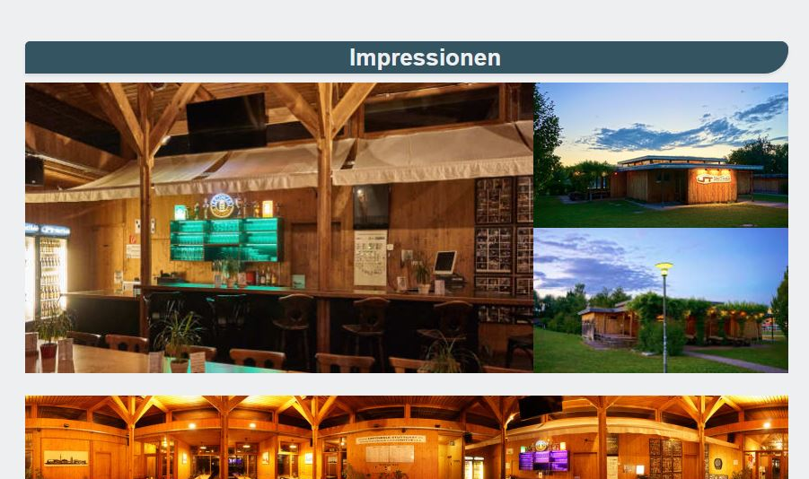
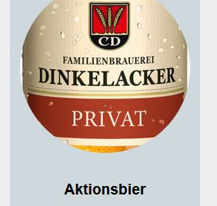
Results – Compliance (cumulative) (3/6)
9.1.1.1a
Alternative texts for control elements
9.1.1.1b
Alternative texts for graphics and other objects
Source: https://www.unithekle.de/
Taken: 29.07.21
Source: https://www.unithekle.de/
Taken: 02.10.21
Notes:
Test step 9.1.1.1a is shown with a snippet of the Unithekle website. This snippet is an image that acts as a link. According to WCAG, the alternative text of the image should state the target of the link, but the overlay tools only insert the text that can be seen directly on the image, i.e. the inscription of a beer bottle, which is incorrect in this case. The link leads to another sub-page of the website
Step 9.1.1.1b showed that the overlay tools recognise certain objects within the image, such as a chair or a lantern, but the basic core message of the image is usually not reproduced.

Slide 14
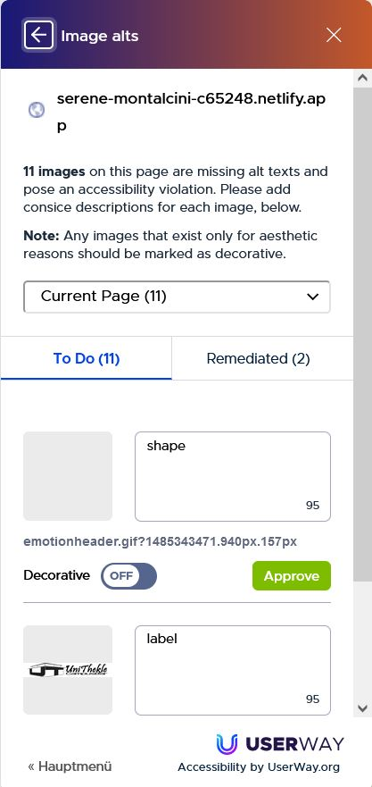
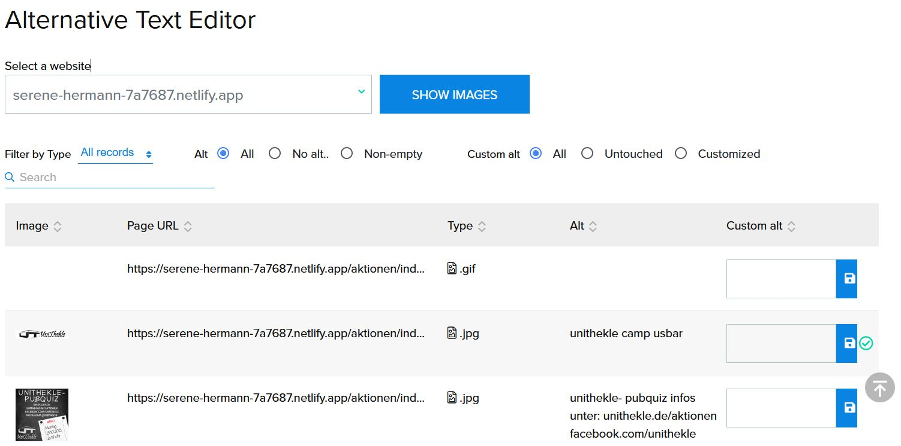
Results – Compliance (cumulative) (4/6)
UserWay
EqualWebs and UserWays Editor for editing alternative texts
EqualWeb
Source: UserWays Alternative Text Editor
Taken: 22.10.21
Source: EqualWebs Alternative Text Editor
Taken: 22.10.21

Slide 15
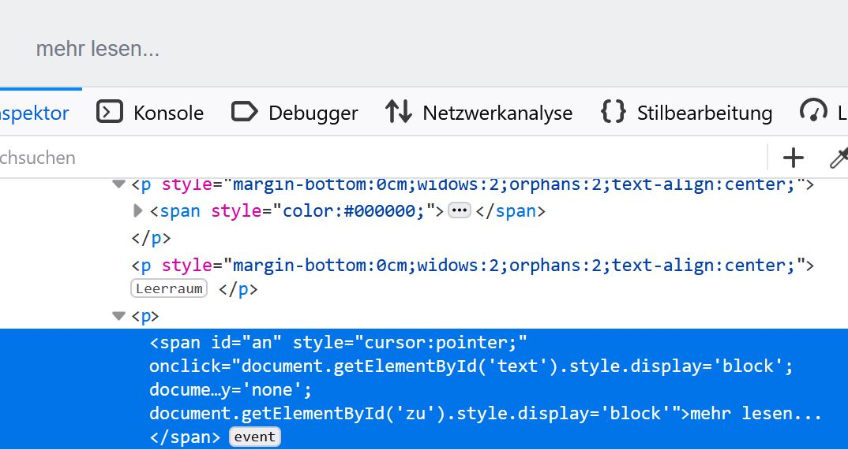
Results – Compliance (cumulative) (5/6)
9.2.1.1
Usable without mouse
( Only accessiBe has automatically added the necessary tabindex attribute )
Source: https://www.unithekle.de/über-uns/
Taken: 14.08.21
Notes:
The slide shows an image of the Unithekle website. You can see a "Read more" button and the corresponding code. This allows you to see that it is not a normal button, but a span element that has been supplemented by an onClick event and is therefore not accessible to keyboard users.

Slide 16
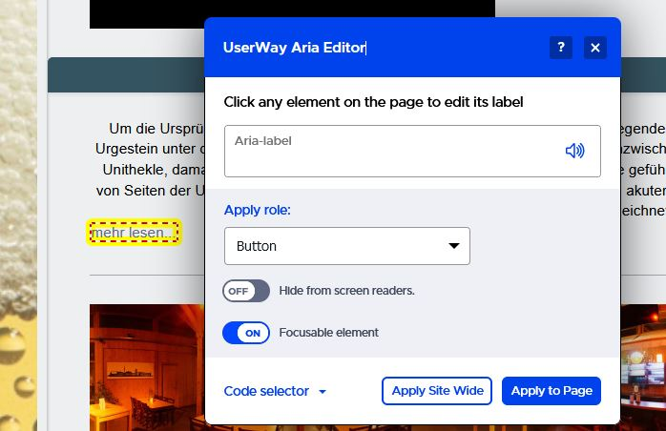
Results – Compliance (cumulative) (6/6)
UserWays
ARIA Editor
Source: UserWay ARIA Editor
Taken: 08.11.21
Notes:
The slide shows a picture of the UserWay ARIA Editor in use. The editor is a small window that is displayed above the website on which the overlay tool is installed. This makes it possible, for example, to select the "Read more" element and then set it as focusable in the editor.

Slide 17
Results – Compliance (holistic) (1/2)
No specific statement about overlay tools from WCAG, but…
„Alternate versions may be provided to accommodate different technology environments or user groups. Each version should be as conformant as possible. One version would need to be fully conformant in order to meet conformance requirement 1. “ [7]
Holistic
The test steps and thus the settings of the overlay tools are considered as a whole

Slide 18
Results – Compliance (holistic) (2/2)
Automatic changes
Metric | Initial situation | accessiBe | EqualWeb | UserWay
Compliance (hol.) | 13 % | 45 % | 30 % | 27 %
Automatic changes + manual adjustments
Metric | Initial situation | accessiBe | EqualWeb | UserWay
Compliance (hol.) | 13 % | 45 % | 36 % | 48 %

Slide 19
Results – Showstopper (1/4)
WCAG conformance requirement 5 (Non-Interference) [7]:
1.4.2 - Audio Control,
2.1.2 - No Keyboard Trap,
2.3.1 - Three Flashes or Below Threshold
2.2.2 - Pause, Stop, Hide
Failure to comply with these criteria may affect the general use of the website and, in the worst case, may cause certain users to have an epileptic seizure [8].

Slide 20
Results – Showstopper (2/4)
WCAG 2.1 criteria | Initial situation | accessiBe | EqualWeb | UserWay
1.4.2 - Audio Control | 0 % | 25 % | 0 % | 75 %
2.1.2 - No Keyboard Trap | 0 % | 100 % | 0 % | 0 %
2.3.1 - Three Flashes or Below Threshold | 0 % | 0 % | 0 % | 0 %
2.2.2 - Pause, Stop, Hide | 0 % | 0 % | 0 % | 0 %
Result | 0 % | ≈ 31 % | = 0 % | ≈ 19 %

Slide 21
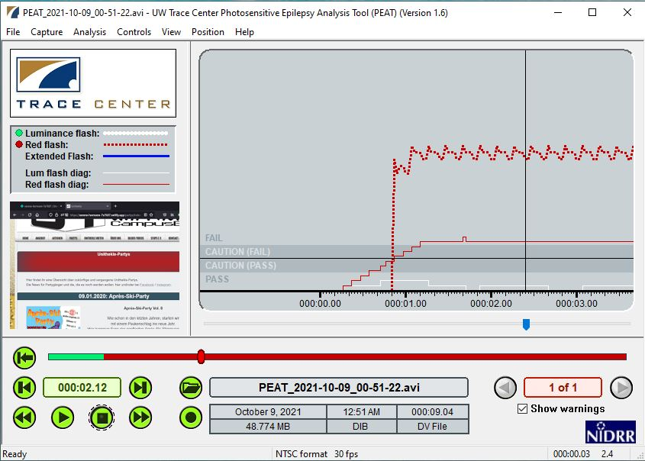
Results – Showstopper (3/4)
No overlay tool automatically stopped the flickering, therefore they all failed
Tool: Photosensitive Epilepsy Analysis Tool from Trace Research & Development Center (Version 1.6)
Notes:
The PEAT tool examines the test website and finds that it contains flickering content which may be a danger to certain people.

Slide 22
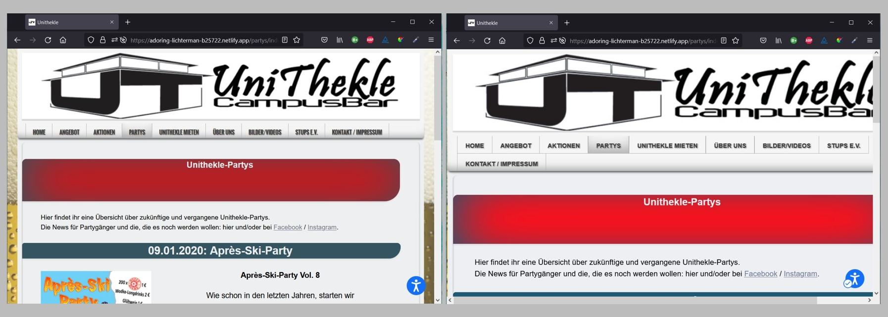
Results – Showstopper (4/4)
Initial
Vision Impaired Profile (accessiBe)

Slide 23
Discussion (1/2)
Assumptions for manual adjustments
The site owner knows
Where the failures are and why they are indeed failures
How to fix them correctly
Source: UserWay ARIA Editor
Taken: 08.11.21
Source: EqualWebs Alternative Text Editor
Taken: 22.10.21

Slide 24
Discussion (2/2)
It can be assumed that in most cases the site owner does not have this kind of expertise
Therefore, only the results of the automatic changes are used for the overall result

Slide 25
Overall result
Metrik | Gewichtung | accessiBe | EqualWeb | UserWay
Compliance (cumulative) | 15.78 % | 45 % | 33 % | 27 %
Compliance (holistic) | 19.22 % | 45 % | 30 % | 27 %
Showstopper | 17.94 % | 31 % | 0 % | 19 %
Implementation | 12.28 % | 1 % | 75 % | 86 %
Feedback | 10.05 % | 0 % | 38 % | 25 %
Configurability of the toolbar | 12.78 % | 74 % | 79 % | 83 %
Training | 11.91 % | 0 % | 25 % | 0 %
Result |  | ≈ 43 % | ≈ 37 % | ≈ 37 %

Slide 26



Limitations
Study conducted from mid to late 2021
Only 29 of 92 test steps of the BIK BITV test were applied
Results may already be outdated
The technologies are continuously developed
Overlay tools were tested on one website only
Several test steps were tested with only one type of failure technique
For example, there are several ways to create a keyboard trap

Slide 27
Conclusion (1/2)
accessiBe achieves the best result in the scope of this work while fixing the most errors.
However, full compliance is clearly not achieved

Slide 28
Conclusion (2/2)
Overlay tool vendors should:
Continue to develop their technologies with WCAG and legal requirements in mind.
Involve and teach the site owner to fix failures that are not covered by the automated solutions.
Communicate the limitations of their technologies more openly

Slide 29
References (1/2)
[1] Overlay Fact Sheet. Overlay Fact Sheet. https://overlayfactsheet.com. 2021. Last accessed 2021/10/30
[2] Henry, B. Accessibility Overlays in Digital Content. https://www.tpgi.com/accessibility-overlays-in-digital-content/. 2020,
May 13. Last accessed 2021/10/30
[3] Kornmeier, T. Not All Accessibility Overlays Are Created Equal. https://www.deque.com/blog/not-all-accessibility-overlays- are-created-equal/. 2020, April 6. Last accessed 2021/10/30
[4] DIAS GmbH. Die BITV 2.0 – Was prüft der BITV-Test, was prüft er nicht?. https://www.bitvtest.de/bitv_test/das_testverfahren_im_detail/vertiefend/ die_bitv_20_was_prueft_der_bitv_test_was_prueft_er_nicht.html. Last accessed 2021/10/30
[5] DIAS GmbH. Überarbeitung von Prüfschritten im Jahr 2021. https://www.bitvtest.de/bitv_test/das_testverfahren_im_detail/vertiefend/ueberarbeitung/2021.html Last accessed 2021/10/30
[6] DIAS GmbH. Beschreibung des Prüfverfahrens. https://www.bitvtest.de/bitv_test/das_testverfahren_im_detail/verfahren.html. Last accessed 2021/10/30

Slide 30
References (2/2)
[7] W3C. Web Content Accessibility Guidelines (WCAG) 2.1. https://www.w3.org/TR/WCAG21/. 2018. Last accessed 2021/10/30
[8] W3C. Understanding Success Criterion 2.3.1: Three Flashes or Below Threshold. https://www.w3.org/WAI/WCAG21/Understanding/three-flashes-or-below-threshold.html Last accessed 2021/10/30

