Slide 1
Open Licensed AAC in a Collaborative Ecosystem
David Banes and E.A. Draffan
https://globalsymbols.com/
Notes:
Abstract: Abstract:
A collaborative ecosystem that encompasses the use of open-licensed augmentative and alternative communication (AAC) solutions and systems has the potential to provide positive outcomes for children with severe speech and language difficulties. This has been shown through a project that highlighted the willingness to provide a considerable amount of teamwork and participation of families and carers involving 124 children with complex communication needs across three Eastern European countries. Participation was based around a UNICEF hub in each capital city. The hub provided support for small groups of AAC experts sharing their knowledge with limited resources and widely varying groups of other professionals, families and carers of potential AAC users. Initial face to face training sessions provided introductory sessions to open licensed AAC solutions and systems. These sessions were backed up by ‘anytime’ access to an open licensed eLearning platform containing freely adaptable interactive AAC online training resources to be translated into modules by participants in each country. The level of content was based on the first three levels of the European Qualifications Framework. There followed the development of pictographic symbol sets to enhance the localization of already available sets suitable for children. Cultural, linguistic, and social settings were catered for within the open-source Cboard communication app using translated symbol vocabularies and text to speech on an Android tablet. A paper-based board building and symbol creation system, as part of a web-based multilingual symbol repository, provided the ability to make alternative communication boards. Feedback and formal evaluations provided by parents, carers and professionals showed that the benefits to the children were not just in AAC use, but also in their social competency levels, self-esteem and adaptability. Final recommendations included the need for more training to illustrate the benefits of early intervention for those with complex communication needs and to enable more disabled children from hard to reach socio-economic and geographically isolated groups to access cost-effective AAC solutions and systems.
Keywords:
open license, AAC, Augmentative and Alternative Communication, disability, symbols, assistive technology, participatory. PIADS

Slide 2
UNICEF Regional Office for Europe and Central Asia (ECARO) - Background
Relevance of AAC
Out of 240 million children with disabilities in the world, 20 million have communication related disabilities (due to CP, Autism, Trauma);
4 million children in need are 2-4 years old
Language, communication and interaction are foundational for school education and are formed in the early years when the brain is developing rapidly
Early intervention is both more effective and less costly than later remediation
Challenges
Technology-based solutions for communication challenges are unknown, extremely expensive, unavailable in the regional languages, and there are very few local developers
Many professionals do not have the required knowledge and skills to support children and parents with Assistive Technologies.
Limited formal training or university courses available
Widespread myths and prejudices

Slide 3
Key Objectives
Improve availability of open source, customizable, AT/AAC solutions
Improve capacity of professionals to support early inclusion of children with AAC solutions
Support shift from medical to social model of disability
Nurture partnerships and capacity that can build sustainable national AT/AAC ecosystems

Slide 4
Implementation
Rationale and Conceptual Framework
Defining Scope and Stakeholders
Making Symbol Choices
Capacity Development
AAC Symbol Set Design
Introducing Tech AAC
AAC Application Use
Supporting Families
Appreciating Long Term Results

Slide 5

Defining Scope and Stakeholders
Starting Point – what resources and expertise are already available?
Identifying a core partner
Identify stakeholders
Identify international partner
Establish core project and partners
Associate stakeholders with activities
Develop a project plan

Slide 6

Making Symbol Choices
Creating an AAC forum
Choosing a symbol set
Language and vocabularies - defining a core vocabulary
Selection of new symbols for design
Development of symbols by local graphic designer
Voting on newly designed symbols
Publishing the new symbol set with language translations
Integration of the new symbol set with AAC applications (Cboard)

Slide 7

Capacity Development
Selection of participants and skills audit
Planning training delivery
Mapping skills audit outcomes to training content
Development and adaptation of training materials
Training material considerations
Mentoring
Training evaluation

Slide 8
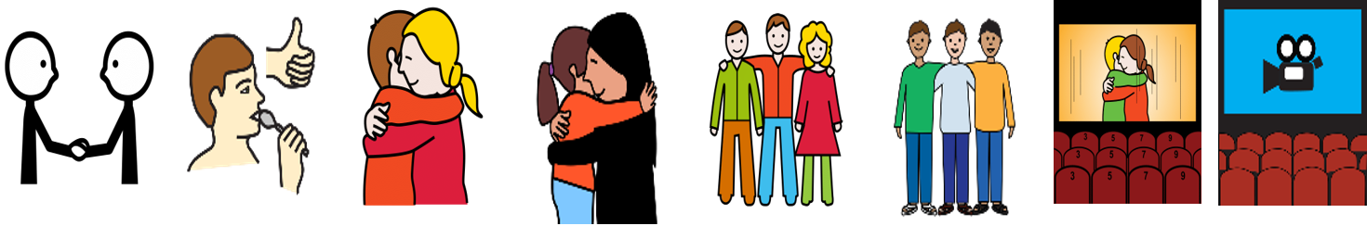
AAC Symbol Set Design
Symbol types
Cultural nuances seen in symbols
Cultural appropriateness at different levels
Co-production and participatory design
Practicalities of symbol design
Symbol set schemas

Slide 9
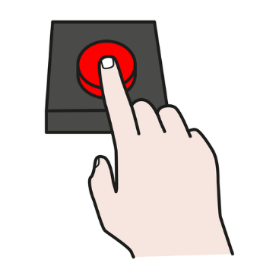
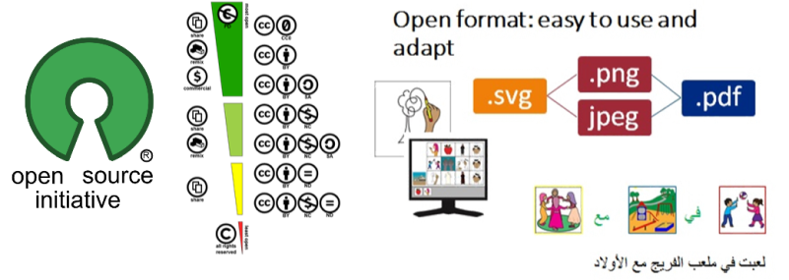
Introducing Tech AAC
Different levels of AAC Tech - different technologies for different - adding access technology to AAC devices.
AAC vocabularies and communication boards
Introduction to Board Builder/Symbol Creator
Open design and
development

Slide 10
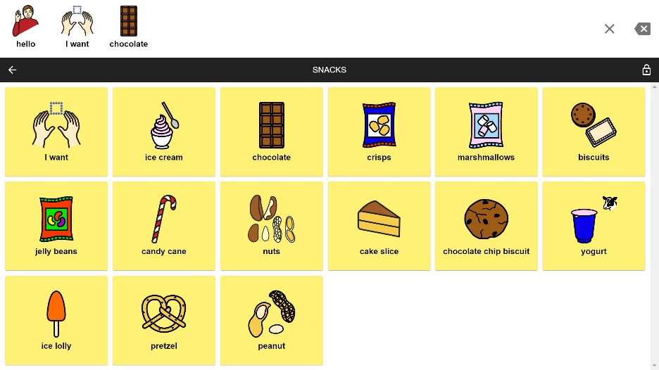
AAC Application Use
Introduction to Cboard
Text to speech solutions and different languages
Interface localisation where translations are needed.
Establishing local testing processes – AAC Forum providing feedback and evaluation as ongoing
processes - Surveys &
Psychosocial Impact of
Assistive Devices Scale (PIADS)

Slide 11

Supporting Families
Understanding needs of families and carers
Early intervention strategies at home
Family and carer involvement – Plan for progression
Thanks to UNICEF Montenegro / Duško Miljanić / 2020 Bojana and her sister Marija using C-board application which makes communication easier for children with disabilities, in Cetinje, in July 2020.

Slide 12
Appreciating Long Term Results
Countries involved with the UNICEF “A Voice for Every Child” programme after two years results included:
  Increased awareness on the value of AAC/AT
  Strengthened national coalitions for AAC/AT to support use and availability of affordable AAC solutions
  Strengthened collaboration between global and national experts and universities
  University courses and continuous professional development opportunities related to AAC AT available
  National resource centers for AAC AT support
  Professionals (preschool teachers, psychologists, speech and language specialists) use modern methods and means in line with the social model of disability
  Centers of excellence support national design and development of AT solutions
  Markets shaped to improve accessibility and affordability of AT solutions

Slide 13
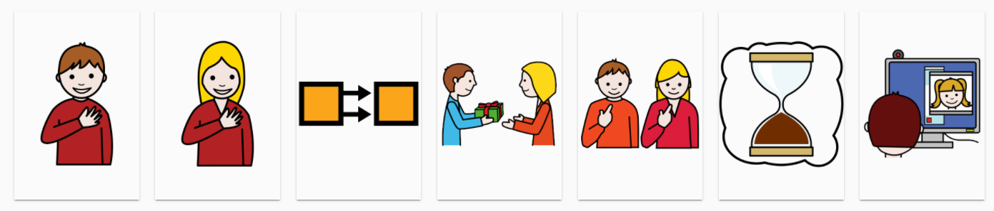
Thank you
David Banes and E.A. Draffan
https://globalsymbols.com/knowledge-base
Thank you also to UNICEF, colleagues and participants in Croatia, Serbia and Montenegro, plus symbol developers including ARASAAC, Tawasol, Mulberry, Jellow and Sclera.

