Slide 1
Conversion of Multi-Lingual STEM Documents in E-Born PDF into Various Accessible
E-Formats
Masakazu Suzuki and Katsuhito Yamaguchi

Slide 2
Background
Digital STEM contents
  Usually provided in PDF
  ←Technical parts are inaccessible for print-disabled people.
InftyReader
  Can convert such PDF into various accessible formats.
  Recently, print-disabled people usually use it to read “e-born PDF.”

Slide 3
E-Born PDF
Produced from a digital file such as Microsoft Word.
  ←Accurate information on each character/symbol such as the character code is embedded.
The other-type PDF: Image PDF
Usually produced by scanning/copying.

Slide 4
A New Method Reported at ICCHP2016
Character information extracted with a “PDF parser” is used to recognize.
  ←Remarkably improve recognition accuracy.
Became able to recognize multilingual STEM contents without a special (image-based) OCR engine for each language.
However, this method could not be applied for mathparts, and image-based OCR was still used.

Slide 5
PDFContentExtracter
A completely new approach to extract character information from PDF developed by Fujiyoshi.
Vector information of drawing each character/symbol in scalable vector graphics (SVG).
  → Allows us to get a correct graphical rect-area even in a math part.

Slide 6
A New Approach of Math OCR
Structure analysis of math formulas becomes less dependent on the image-based OCR result of characters/symbols.
STEM contents in any Unicode-based language could be recognized and converted into various accessible e-formats without a special image-OCR engine.

Slide 7
Workflow (1)
(1) Converting e-born PDF into SVG with PDFContentExtracter.
  Converted into SVG consisting of three types of elements: characters, images and path elements
(2) Analyzing the SVG
  Makes the SVG include only texts in black for recognition
(3) Checking the character code of each math symbol
  Checks the character codes of each font used in a target PDF by making use of image-based OCR to avoid misrecognition.
(4) Judging a font category

Slide 8
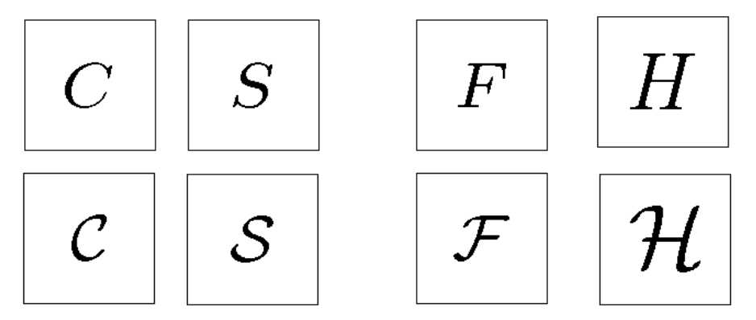
Distinguishable and undistinguishable characters between Italic and calligraphic

Slide 9
Workflow (2)
(5) Structure analysis of math expression
  Essentially the same as our conventional method.
(6) Segmentation of text and math elements.
  Short-length words appearing in that local text should be distinguished from math elements such as sin, cos, log, etc.
After completing these steps, the recognition result can be converted into various accessible e-formats.

Slide 10
Multilingual Support in GUI
All menu items, button names, etc. are loaded from a definition table, in which any Unicode characters can be used to represent those GUI items.
  ←The GUI can be represented in a Unicode-based local language.
French and Vietmanese GUI versions have been actually released.

Slide 11
Evaluation
By using the new math-OCR method, an e-born-PDF math drill book in Vietnamese was converted into some accessible formats.
  ← Evaluated by several Vietnamese end-users in Hanoi at a small online workshop.

Slide 12
Future Works
Corresponding to other Asian languages represented in non-Latin characters such as Chinese, Hindi, Arabic, etc.
Analyzing STEM contents having complicated layout correctly.

Slide 13
Contact Information
NPO: Science Accessibility Net (sAccess Net):
  e-mail: toffice@sciaccess.net
  URL: http://www.sciaccess.net/en/

