Slide 1






Living at Home with Dementia
Challenges during the Night
ICCHP-AAATE July 13 2022
Anne-mie Sponselee & Marianne Nieboer

Slide 2

Relation sleep & health
Sleep
Health

Slide 3
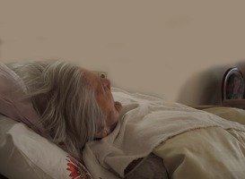
(Un)healthy sleep
Sufficient sleep pressure
Right timing
Comfortable body
Peaceful mind
(de Niet, 2016)

Slide 4
Good night, better day
Research sleeping problems in elderly with cognitive challenges
Transparency in sleep and bed rituals
Problems experienced by elderly and there informal care givers, during the night
Technological applications to improve living at home (independently)

Slide 5
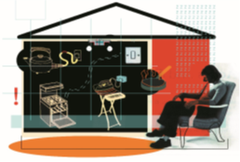

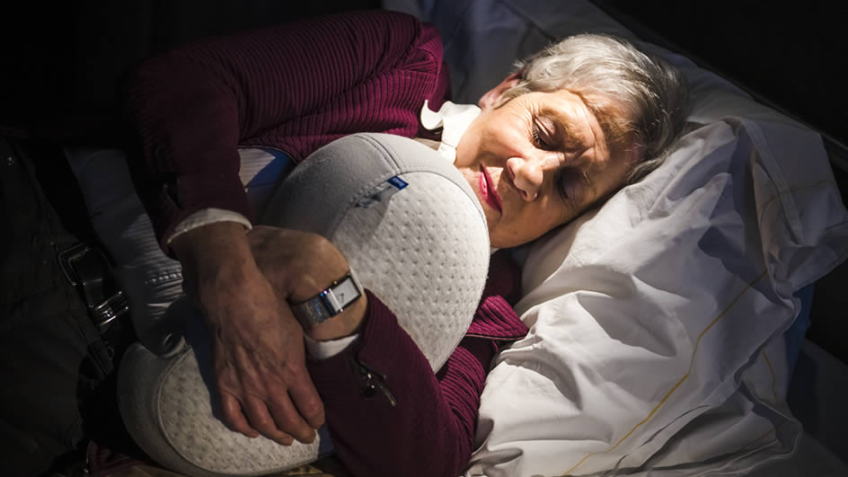

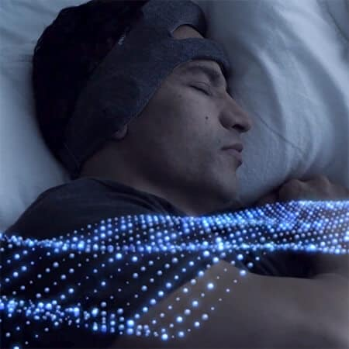
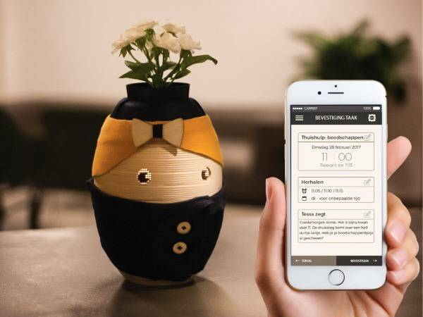

Technological interventions

Slide 6
What do we want to achive?
To understand the situation during the night with respect to ethical and personal differences
So it becomes clear where opportunities lie in technology and related services.
To support living at home with dementia.

Slide 7
Approach
What did we do?
Recruiting persons with dementia, informal caregivers and healthcare professionals
Individual semi-structured interviews and a focusgroup
    Day/night rhythm: daytime napping, activities during the day, eating patterns, difficulties during the night
    Evening routine: eating and drinking patterns in the evening, screen usage, need for sleep
    Causes and effects of sleep disturbances: health situation, medication, physical condition of bedroom, daytime functioning, mood and fatigue

Slide 8


Research on challenges during the night
83
59
Elderly people with dementia
85
83
86
Informal caregivers
82
74
Healthcare professionals

Slide 9
Empathy Maps
https://app.mural.co/t/fontyshogeschoolmensengezond8807/m/fontyshogeschoolmensengezond8807/1649256915079/b0d40a9d78c5f906923ce1fc2be61414012132ba?sender=udaf98e5dfec129493a6b4709

Slide 10
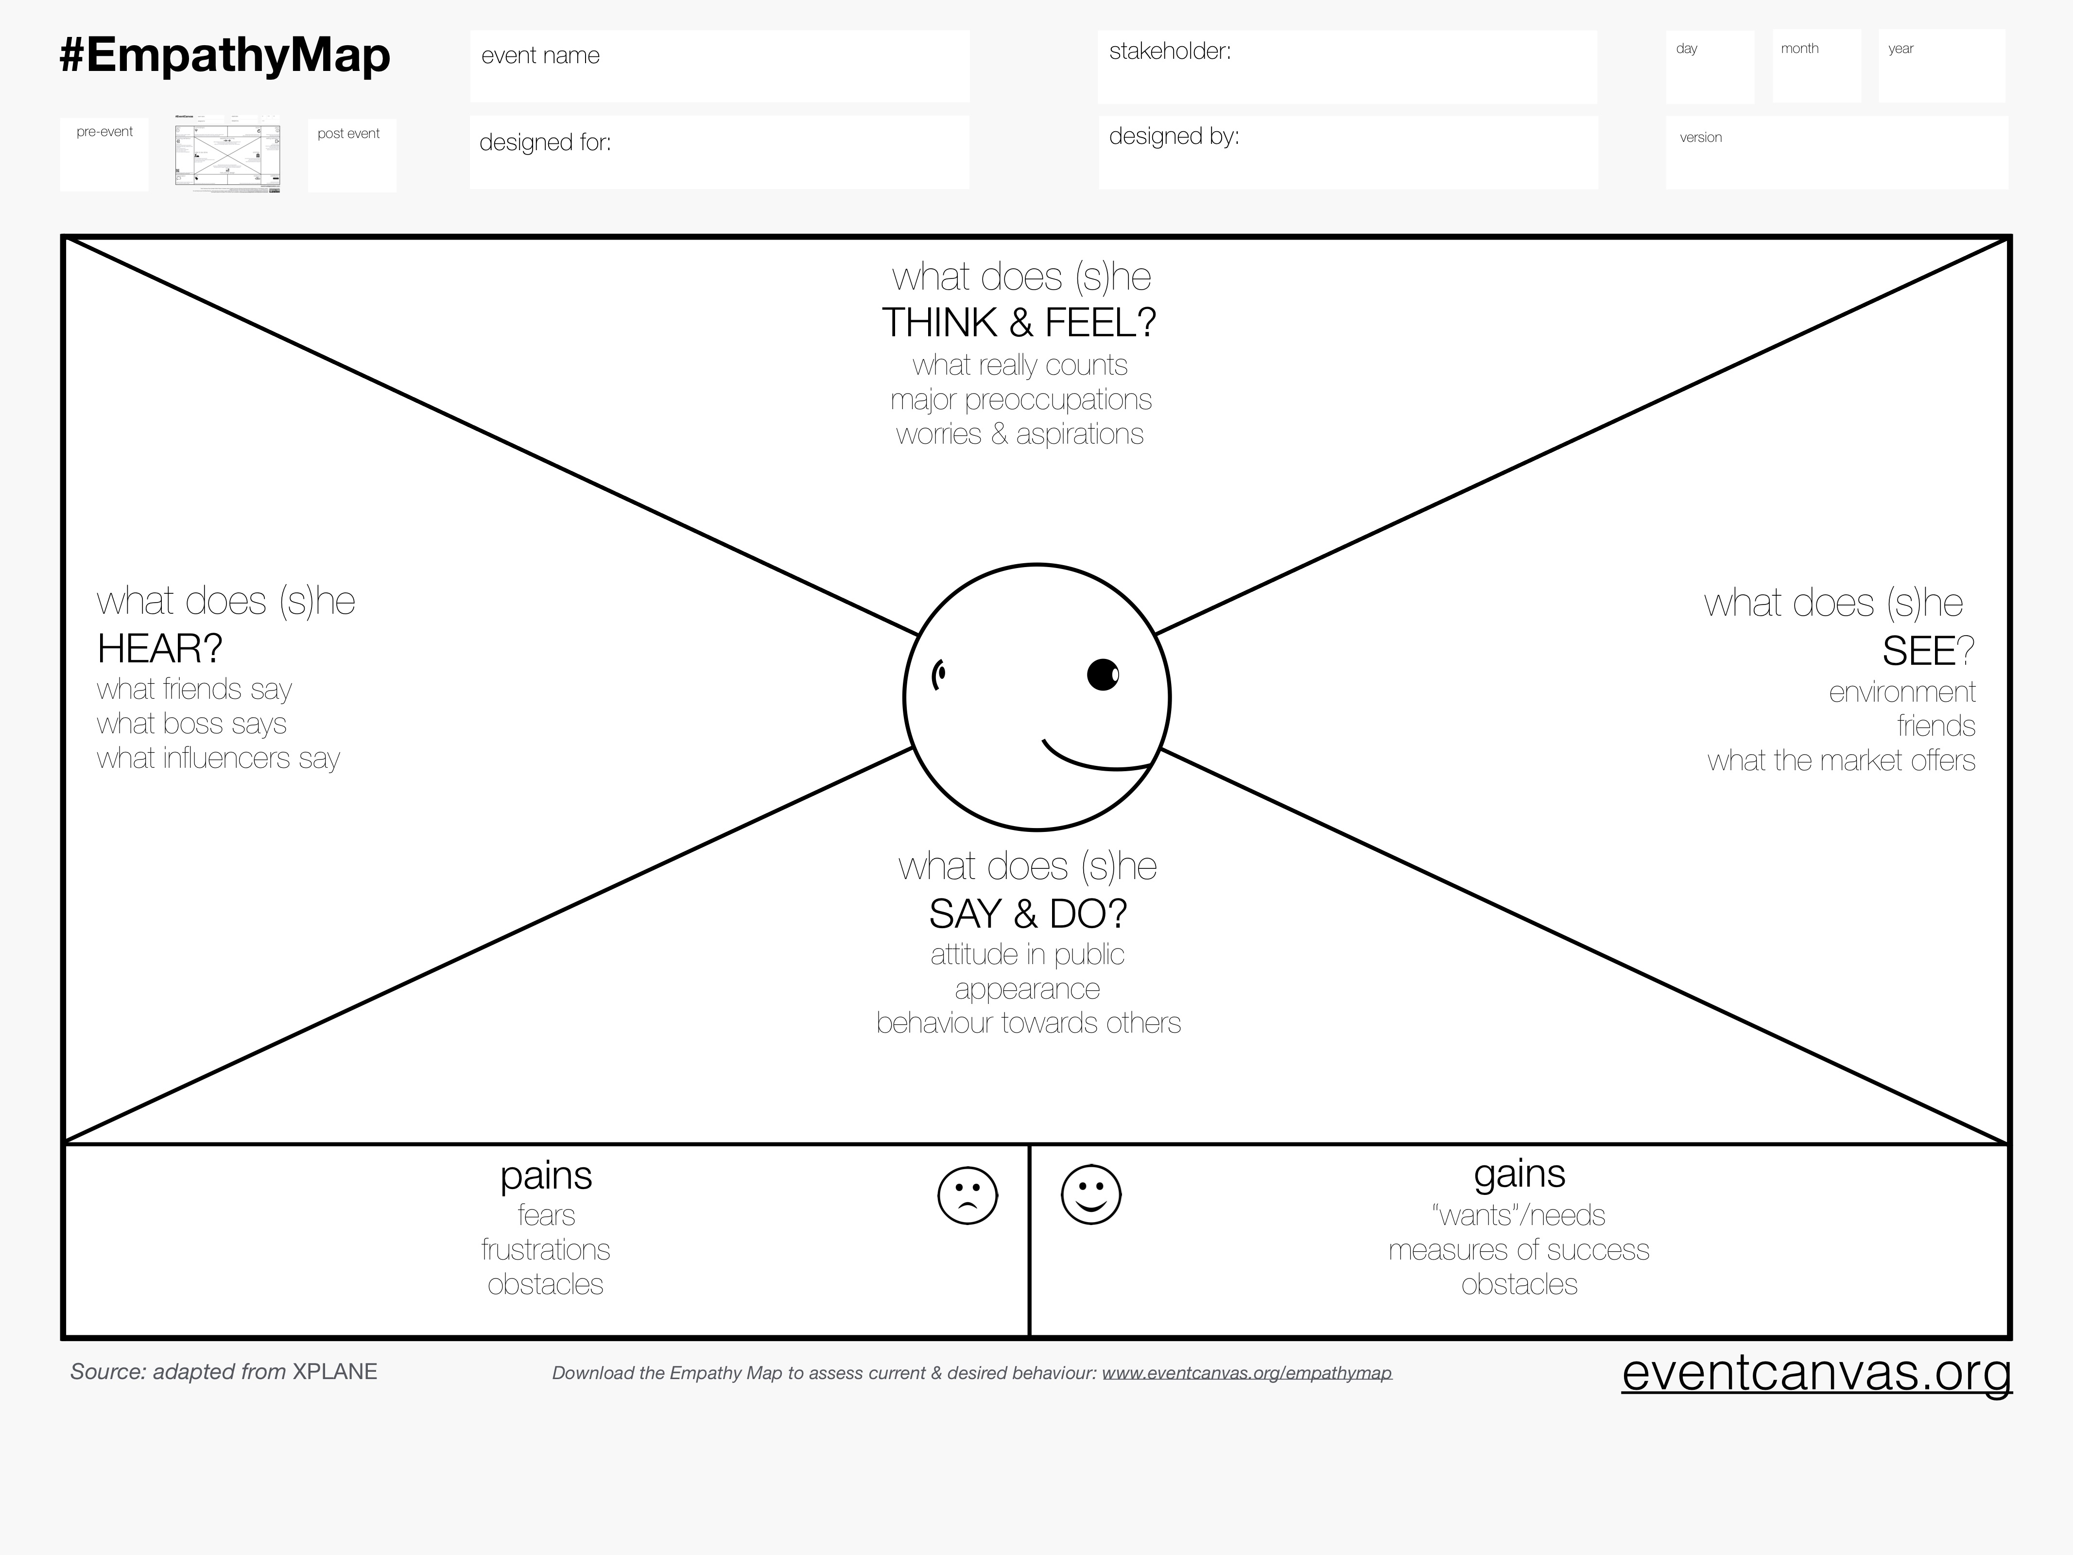

Slide 11
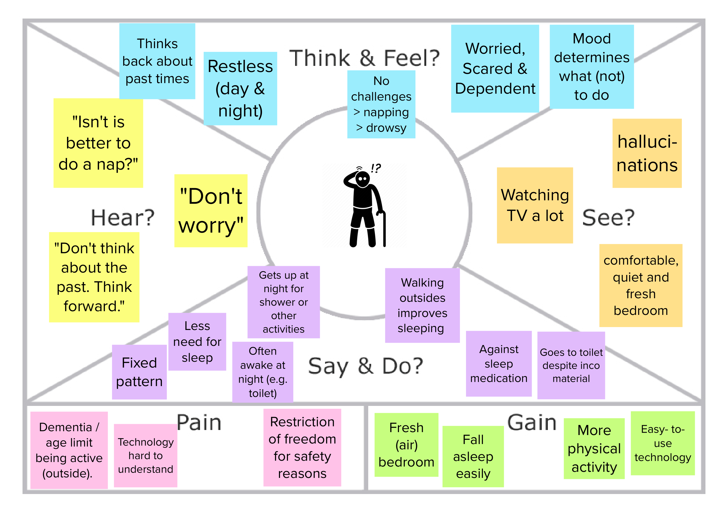

Slide 12
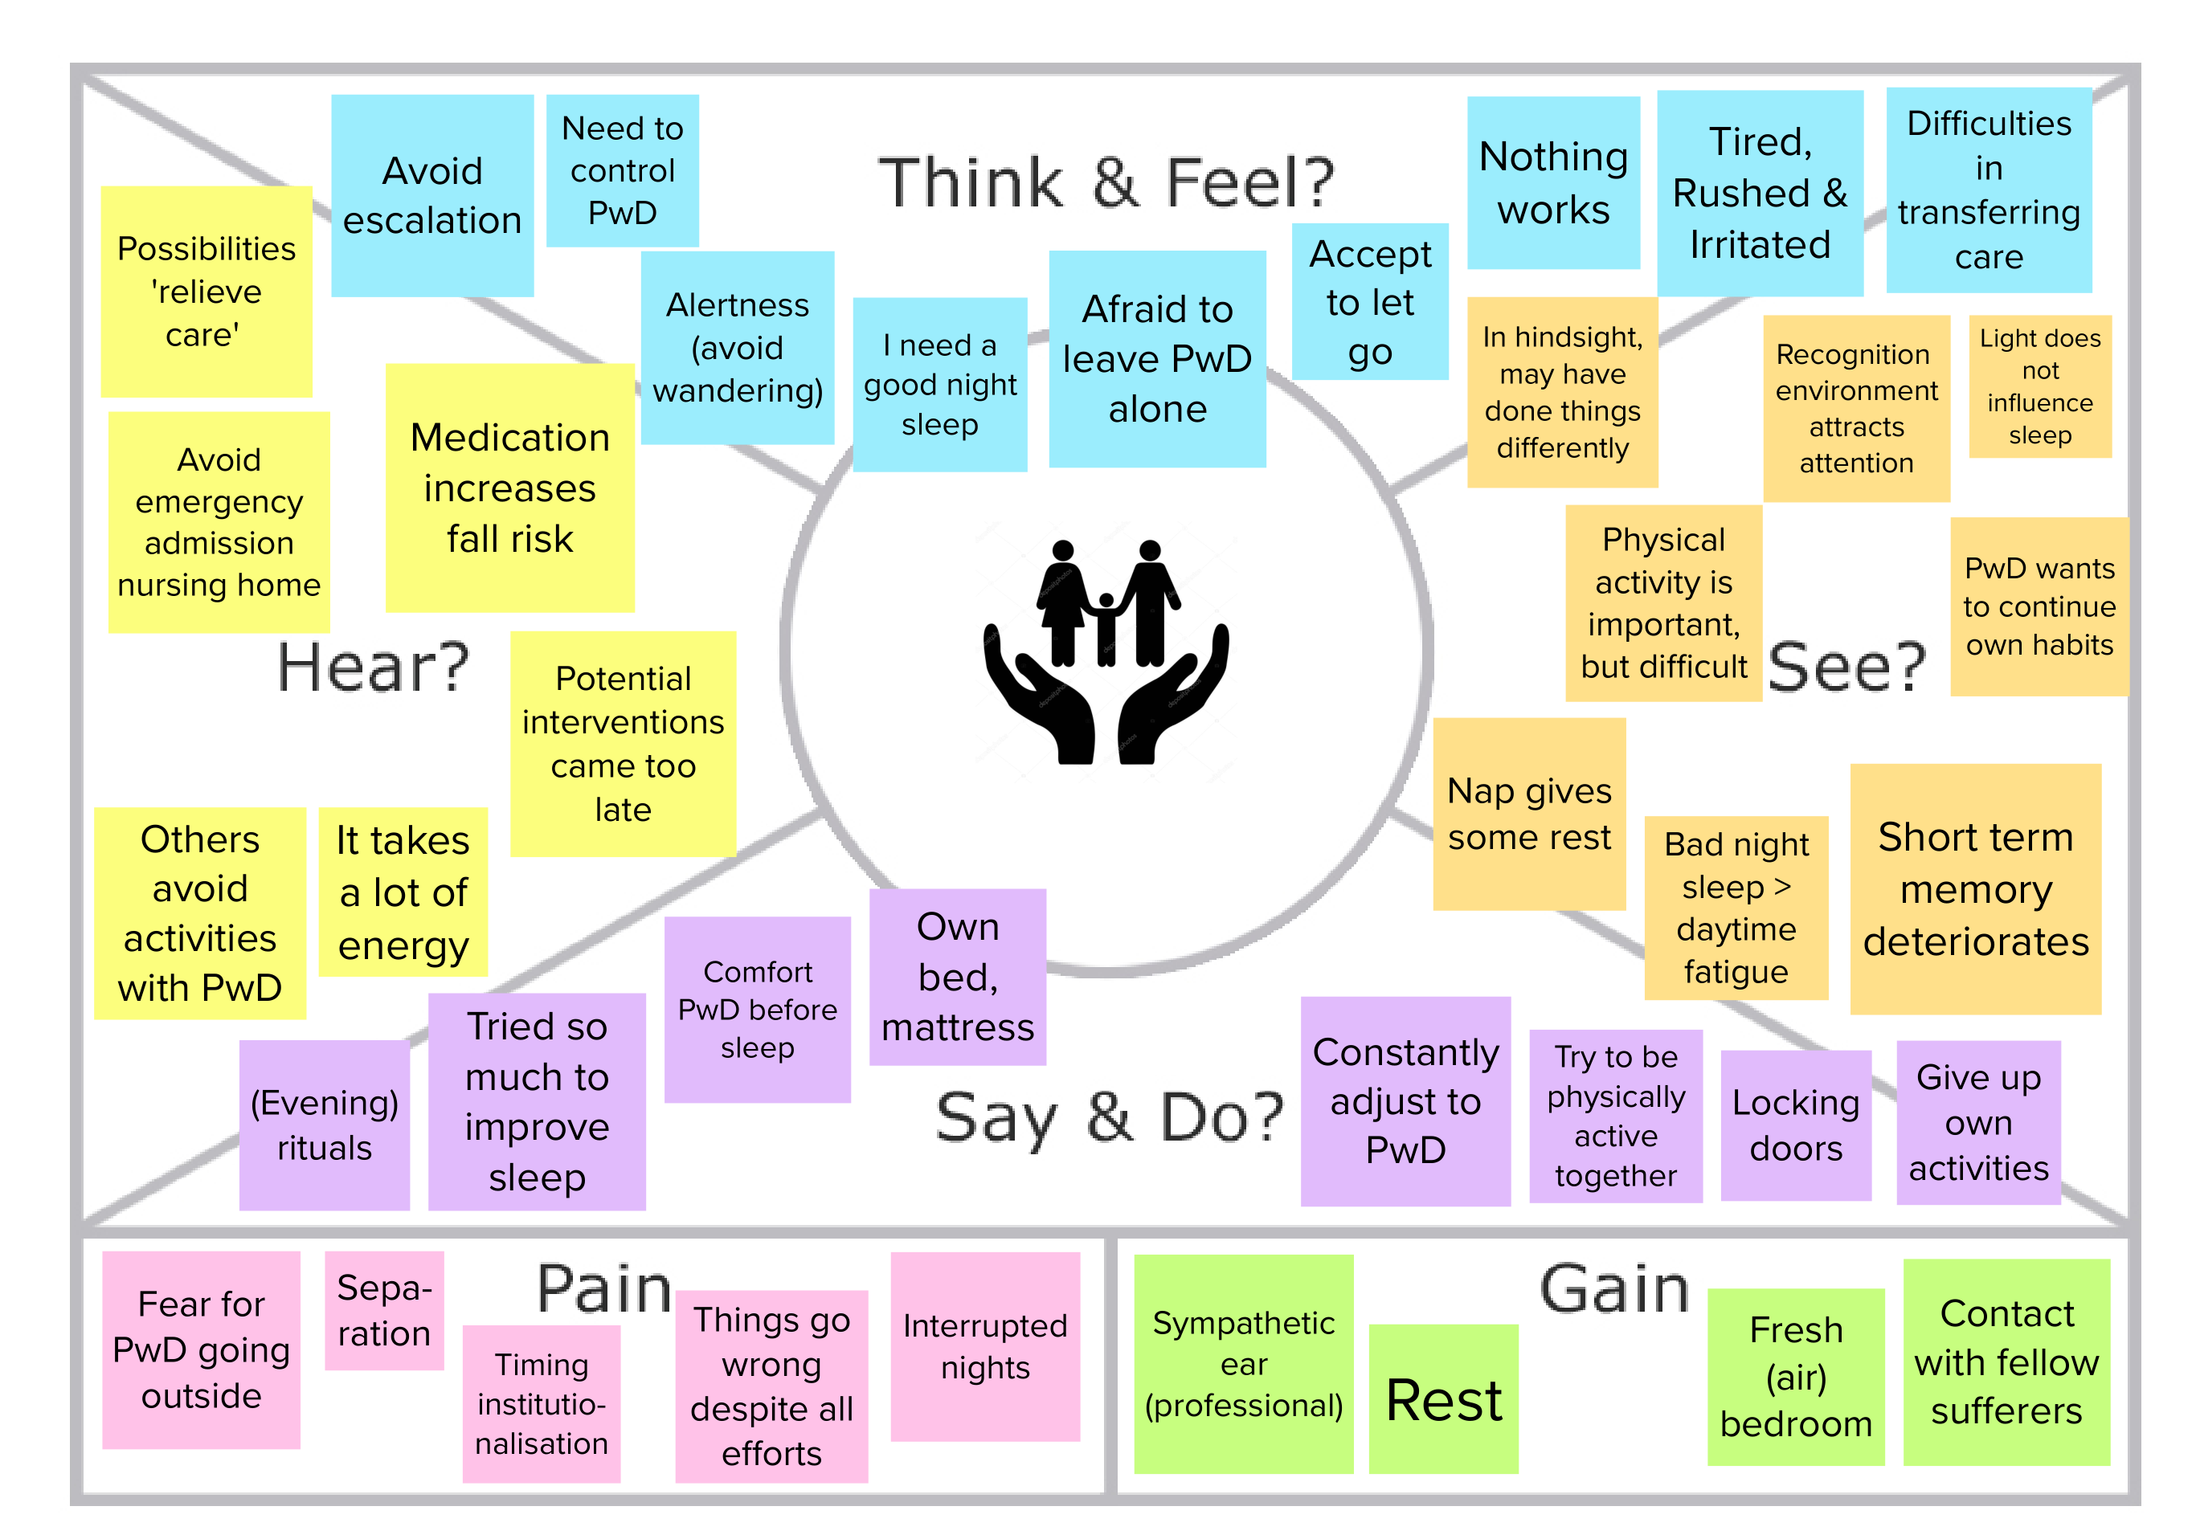

Slide 13
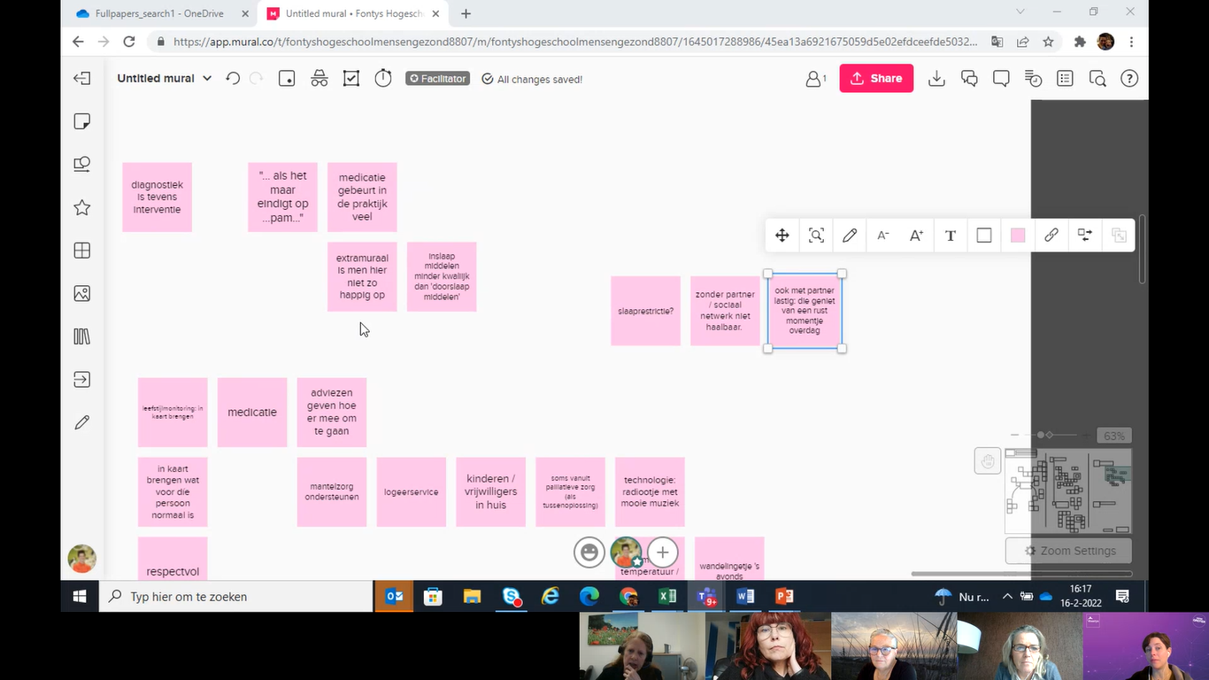
Research on challenges during the night
Online focus group with 3 healthcare professionals

Slide 14
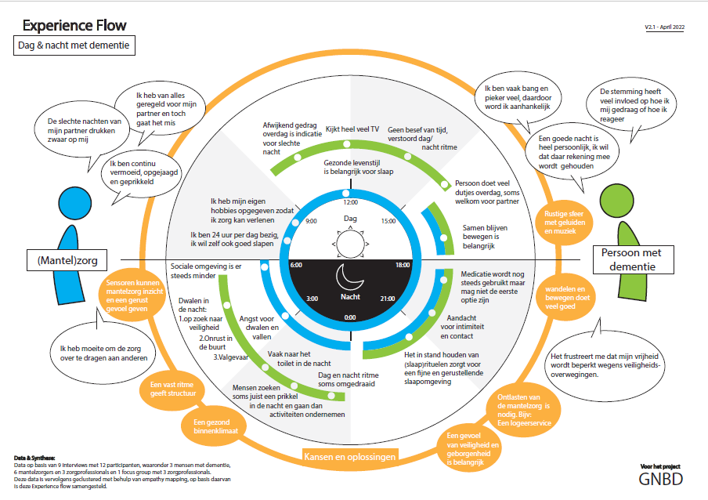
A good night differs for everyone
Contantly tired, rushed and agitated
Gave up own hobbies to take care of loved one
Informal care
Sleep medication is being used, but should not be the first option
Person with dementia
sensors
Wandering:
Looking for safety
Risk of falling
Impact neighbourhood
Uncomfortable in transferring care for loved ones to others
Frustrated my freedom is limited for safety reasons
Healthy ventilated environment
Sense of safety & securiy

Slide 15
In conclusion
Lack of attention for quality of sleep & sleep disturbances, especially in dementia care.
Knowledge and discussion about good sleep will increase the potential for tackling problems
The perspectives of people with dementia and their formal and informal carers give more insight in the problems.
Structure in day and night activities seem crucial. Activities, both physical and mental, during the day influence the need for sleep during the night.
The use of empathy maps is experienced as an effective tool to get insight in personal habits and behaviours of people suffering from dementia are collected.
These insights are shared with those involved in determining the person-centred dementia care, and those developing supportive technologies.

Slide 16
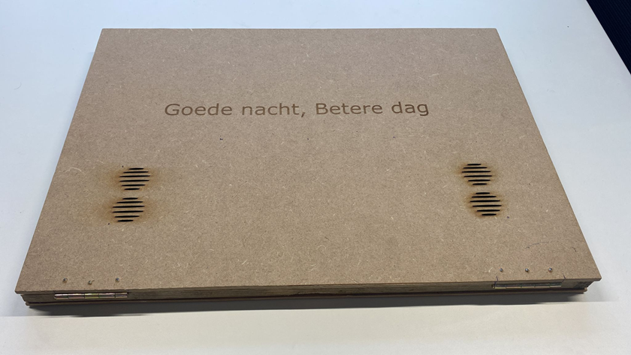
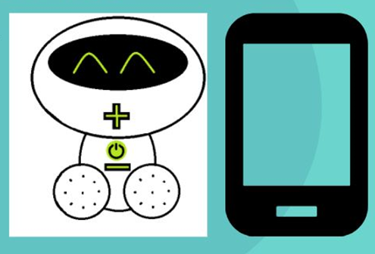
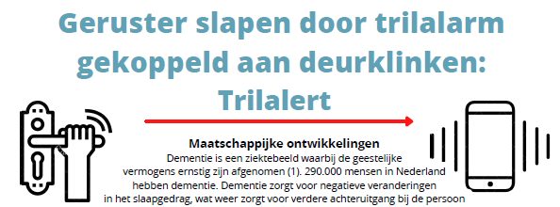
New ideas
Better nights for elderly people with dementia by (increased) knowledge of buddies
THE VOICE BEAR
INFORMATION VIDEO ON SLEEP
& DEMENTIA
Sleep diary
Better nights due to Bedroom Service
News Paper Article for Informal Caregivers

Slide 17
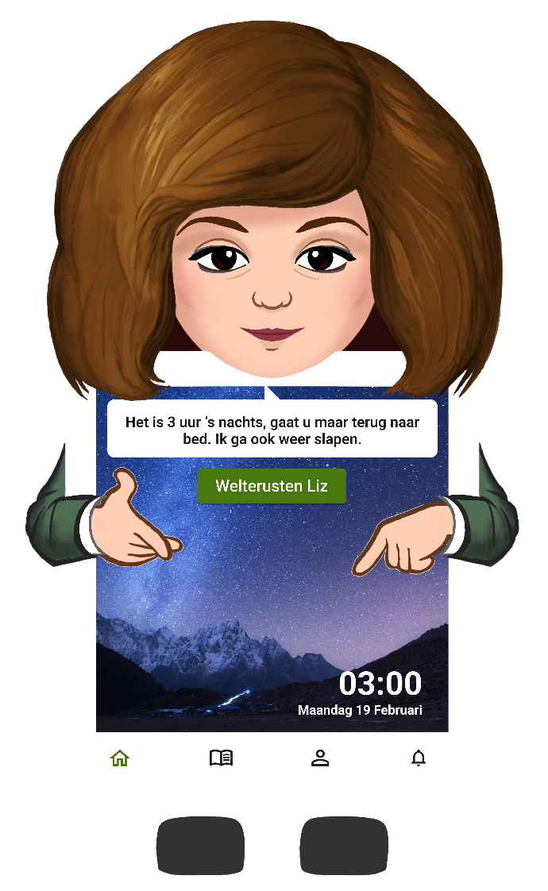




Liz as night nurse
What does Liz do as night nurse?
Detect whether a person has left his/her bed with a bed sensor
Comforting messages nuring the night
Peaceful music or sounds when having difficulties sleeping
Alarming informal carer when needed

Slide 18
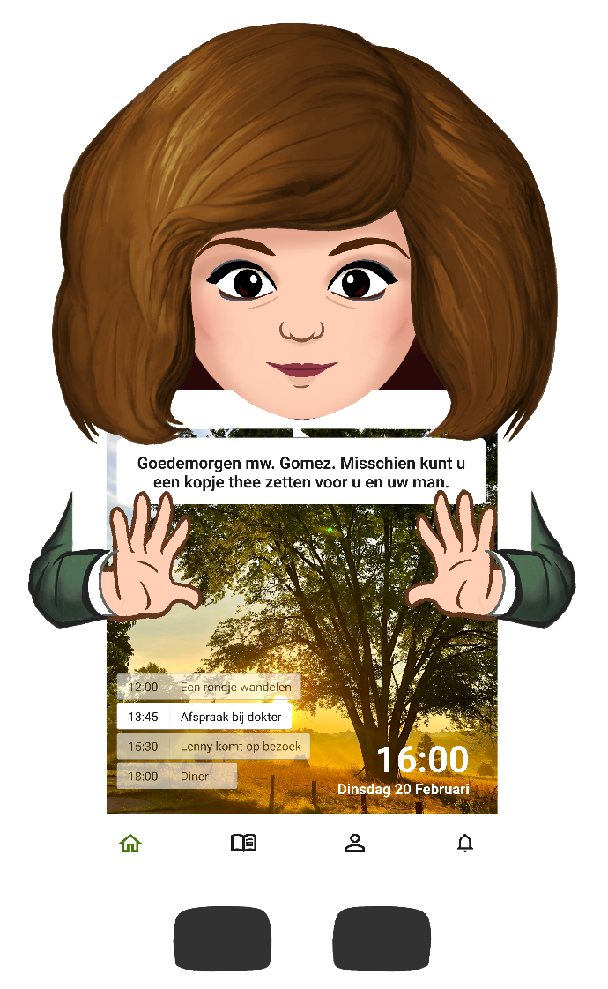


Liz for day structure
How does Liz help with day structure?
Liz gives suggestions for fun activities
Liz gives reminders for appointments and planned visits that are coming
Liz support in daily tasks like making a cup of tea or coffee

Slide 19
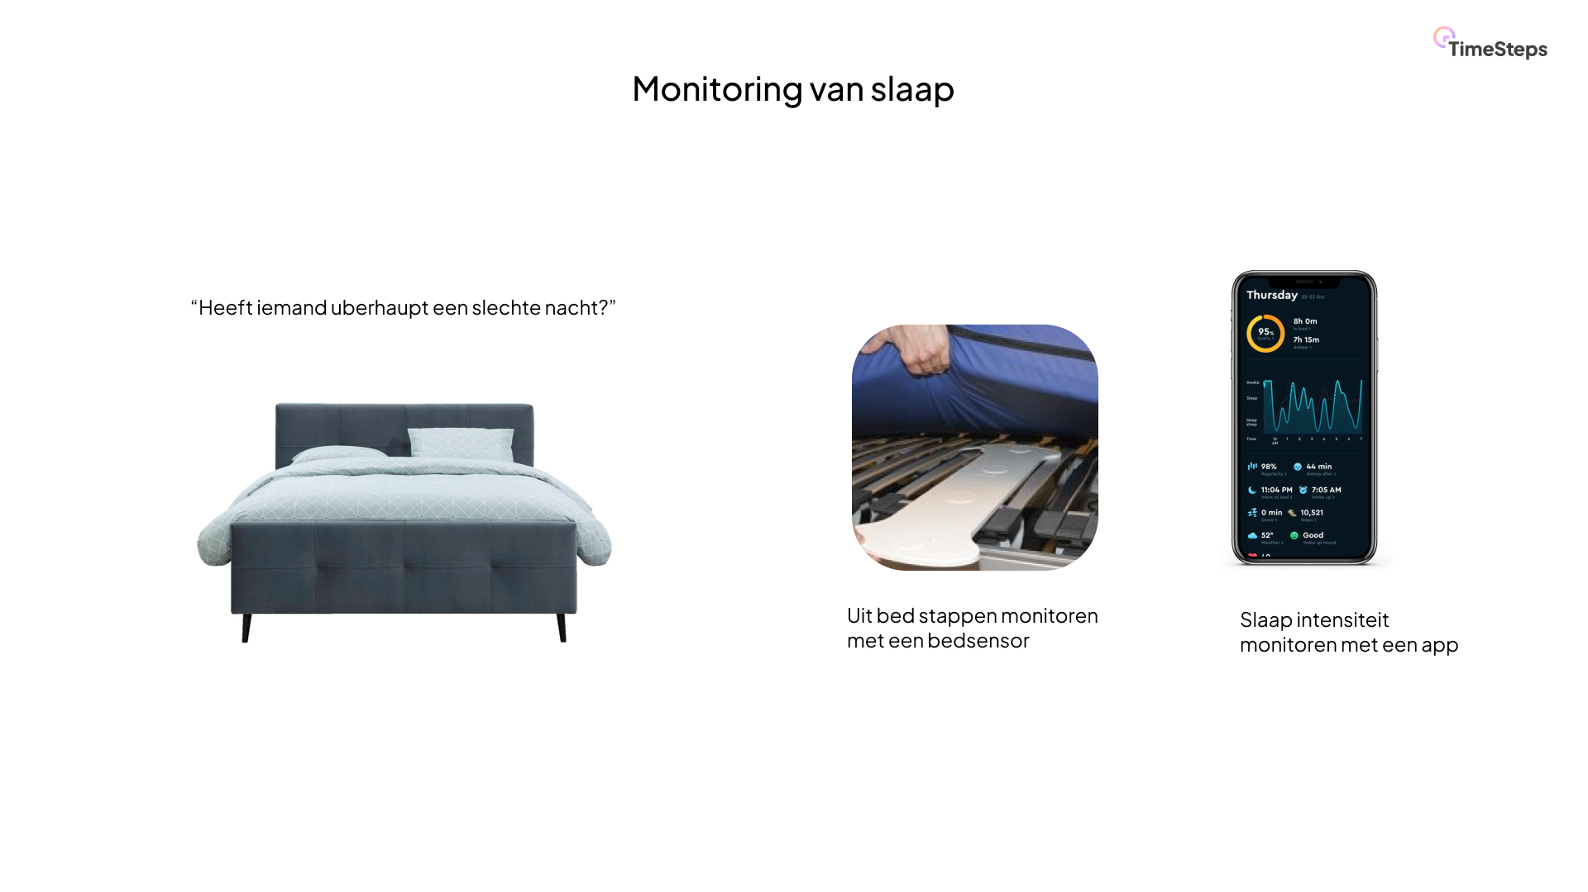

Slide 20
Thank you.
m.nieboer@fontys.nl
a.sponselee@fontys.nl
r.brankaert@fontys.nl

