Slide 1
Indoor Query System For The Visually Impaired
Lizhi Yang, Ilian Herzi, Avideh Zakhor, Anup Hiremath, Sahm Bazargan, Robert Tames-Gadam
Notes:
Hello everyone, today I am presenting a new Indoor Query System for the visually impaired

Slide 2
Outline
Motivation
Hardware Design
System Operation
Object Detection Model
Data Collection
Experimental Results
Future Work
Notes:
This session will be split into 7 parts –our motivation for this project, our hardware components and design, the operation pipeline of the system, the object detection model, data collection, experimental results and future work.

Slide 3
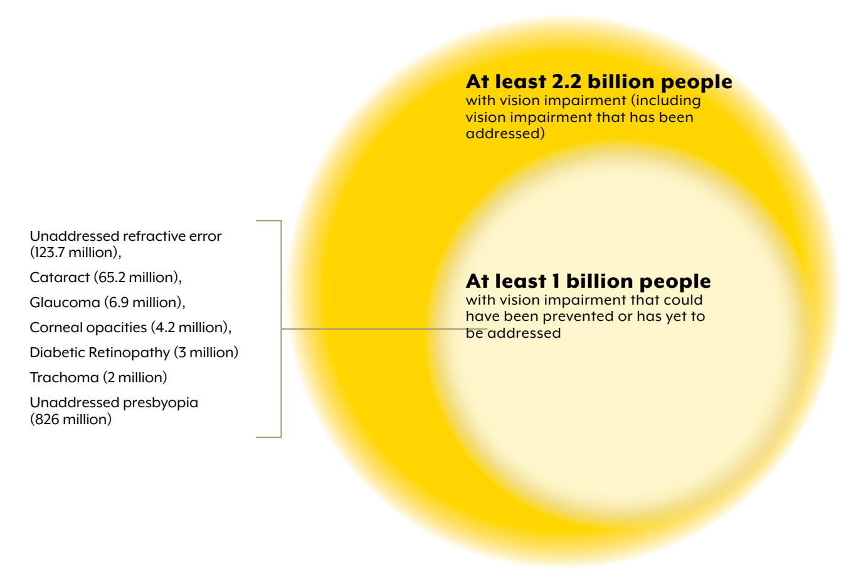
Motivation
According to the 2019 WHO World Report on Vision, at least 2.2 billion people have a vision impairment globally.
Goal: Design a visual query system for the visually impaired
Organization, W.H.: World report on vision. World Health Organization (2019)
Notes:
First, motivation. Our motivation comes from the 2019 WHO world report on vision, where it stated that at least 2.2 billion people have a vision impairment globally. Even though people with severe vision impairments such as blindness is only a fraction of this number, it is still a huge population to consider. This got us thinking, what can we do for them? Since the advent of smartphones, people have continually had access to powerful, mobile compute devices with cameras and microphones, which provides basic capabilities of sensing the environment, so this is where we start.
The plot on the right is from the World health Organization on the distribution of people with visual impairments. The big circle is the estimated number of people with vision impairments, a number of at least 2.2 billion, and the small circle is the estimated number of people with vision impairment that could have been prevented or has yet to be addressed, at a number of at least 1 billion.

Slide 4
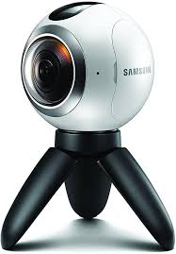
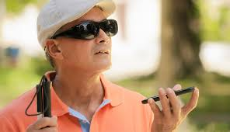
Exploit Recent trends in hardware and Software
Availability of 360° cameras to locate points of interest (POI) surrounding a person
Depth enabled smartphones to detect distances to POI
Low complexity deep learning networks for automatic object recognition running nearly real time on smartphones
Accurate speech to text and text to speech capabilities on smartphones allows verbal communication between visually impaired and system
Notes:
First and foremost, to have a comprehensive understanding of the environment, just the camera on the phone is not enough. Thus we turn to 360 cameras for the rescue. 360 cameras give us the capability to locate points of interest, POIs surrounding the person. Some smartphones also come with depth sensors, further enabling use to detect distances to these points of interest. Advancement of deep learning networks and tools make it possible for user to run low complexity networks with acceptable accuracy for near-realtime detection on smartphones. Accurate speech to text and text to speech capabilities on smartphones also allow for verbal communication between the visually impaired user and the system.

Slide 5
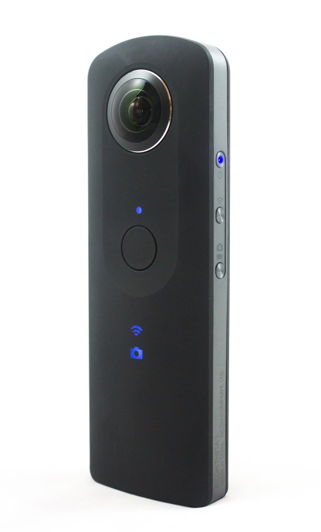
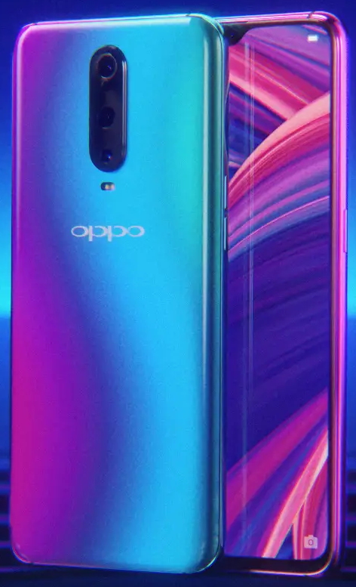
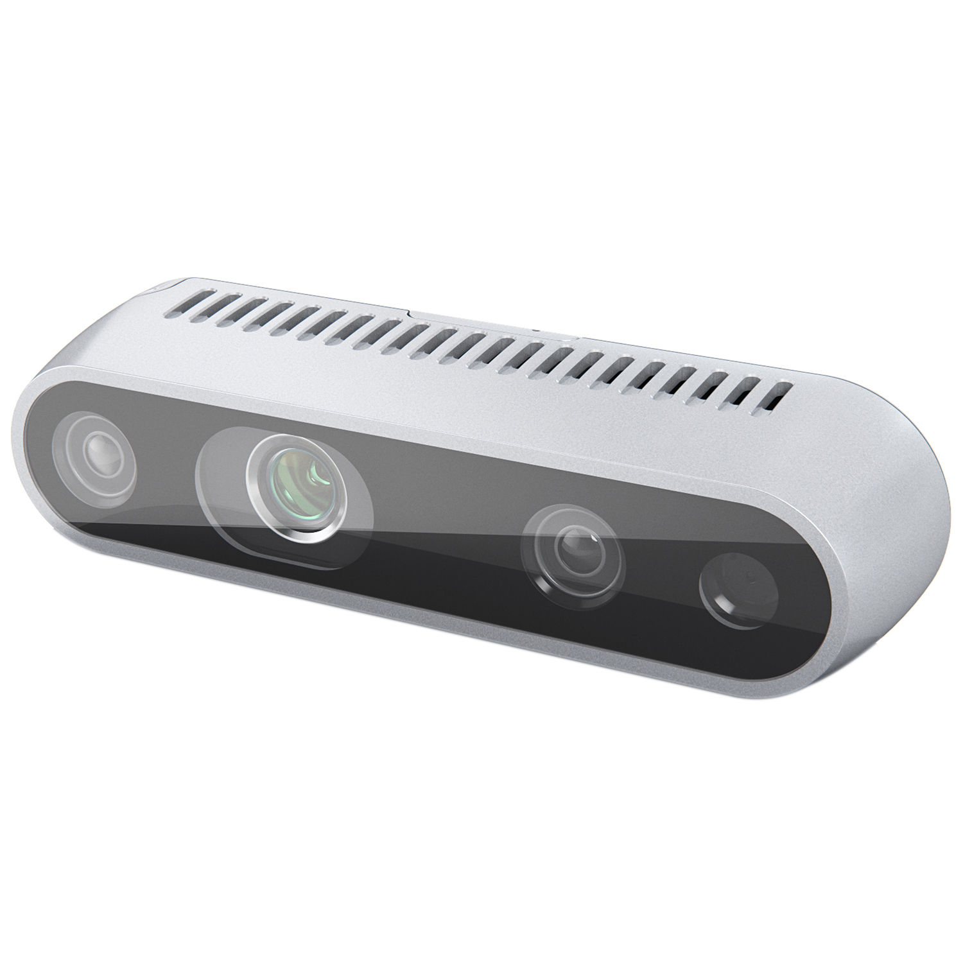
Hardware components
Core of the system: Smartphone and 360° camera, e.g. Theta V from Ricoh
Depth camera: Intel RealSense D435 / ToF camera
New smartphones with depth sensing e.g. OPPO R17 Pro, or Samsung Galaxy 10
Ricoh Theta V 360° camera
Oppo R17 Pro
Intel RealSense
Notes:
(point to each device as you are going through. No need to first explain the bullets and then explain the pictures; point to the exact location of the depth sensor on Oppo if you can)
Next, the hardware components and design. We chose the following hardware for our project. First we have a Ricoh Theta V camera that is a panoramic camera featuring wi-fi and usb development APIs, which enable an app on the phone to take pictures with Theta V and process them locally. Next we have the depth camera, the Realsense D435, an intel product that is also developer friendly and also has APIs and libraries for mobile development. We also tested the ToF camera on the Oppo R17 Pro in substitution of the Realsense, since there would be fewer things to carry around if the phone comes equipped with a depth camera, making it easier for the users.

Slide 6
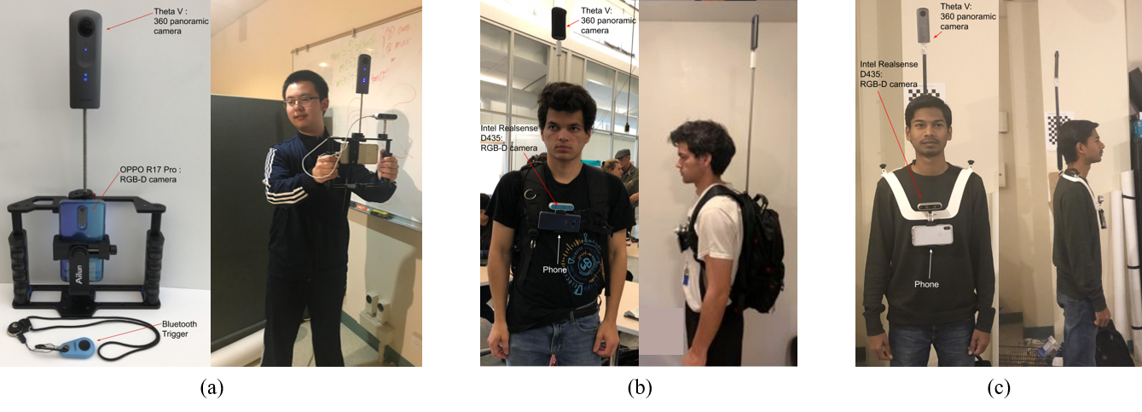
System design:
Three visual query systems: handheld, backpack, shoulder ring
System responds to user queries about specific objects or POI
Ergonomics:
Elevate the 360° camera needs to be elevated above the head of the user
Hand-free is preferred by the visually impaired user community
Handheld Backpack Ring
Notes:
Ergonomics is very important for our system since we need all components to be securely fixed on a mount. The design has evolved overtime from a handheld device to a backpack mount and finally to a custom designed, 3D printed shoulder ring. For the 360 camera to have a clear view of everything around the user, it needs to be elevated above the head of the user. We initially designed the handheld platform as a debug device for development. And from the user surveys we conducted, a hands-free experience is preferred by the visually impaired user community, and thus we migrated to the second design which uses a backpack as the mount of the 360 camera, depth camera and phone. After further exploration into the ergonomics of such wearable devices, we draw inspiration from project blaid from Toyota and designed a shoulder ring as the mount for the devices, further decreasing the weight of the system, and makes it easier for the users to wear. The system responds to user queries about specific objects or Points of interest.

Slide 7
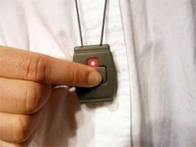
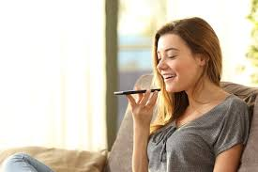
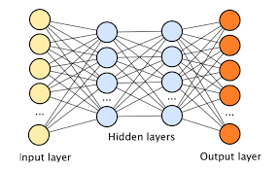
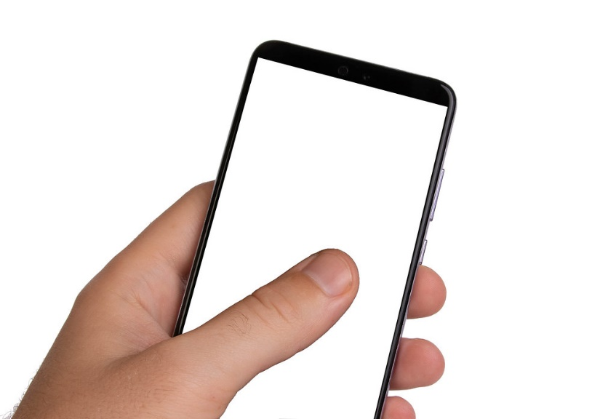
System Operation and user interface
User clicks on a blue tooth button on a ring around his/her neck
This activates the smartphone to “listen” to what the user is asking for example:
elevator, light switch, door, restroom, etc
Smartphone converts speech to text
360° camera takes a picture; 360° picture is divided into 4 rectilinear smaller pictures each covering a 90° field of view;
Text from (3) and pictures from (4) are fed into object recognition deep networks on the smartphone.
Object detection deep networks finds object of interest.
Smartphone converts text to speech to report angle and/or distance of the desired object
Povey, D., Ghoshal, A., Boulianne, G., Burget, L., Glembek, O., Goel, N.K., Han-nemann, M., Motl ́ıcek, P., Qian, Y., Schwarz, P., Silovsk ́y, J., Stemmer, G., Vesel ́y,K.: The kaldi speech recognition toolkit (2011)
Notes:
Now we are going to talk about the system operation pipeline.The operation of the system is simple. The ser clicks on a blue tooth button on a ring around his/her neck. This activates the smartphone to “listen” to what the user is asking for example, elevator, light switch, door, restroom, etc. The Smartphone converts speech to text, and the 360° camera takes a picture; 360° picture is divided into 4 rectilinear smaller pictures each covering a 90° field of view illustrated on the right, with the blue circle denoting the 360 degree picture, the 4 green lines are the 4 rectilinearized images, and the orange dashed lines show the field of view of each image; The Text from step (3) and pictures from step (4) are fed into object recognition deep networks on the smartphone. The Object detection deep networks finds object of interest. And the Smartphone converts text to speech to report angle and/or distance of the desired object

Slide 8
System Operation (cont’d)
Object of interest (door)
2m
user
Two modes of operation both triggered by Bluetooth:
Single click: system reports back relative location of object of interest by using clock notation to denote the “angle”
Double click: invokes depth camera;
system reports back distance of the requested POI if within field of view of depth camera:
Works with depth enabled smartphones or external depth sensor.
360° camera
Rectilinearization
Report specific queried object of interest
Single click
User query
Object detection model
Depth camera & front RGB image
Depth map / RGB registration
Report object of interest and distance
Double click
Notes:
There are two modes of operation that can be triggered, and the operation pipeline is as follows:
If the user clicks the Bluetooth trigger once, the system reports back relative locations of the queried object of interest by using clock notation to denote the angle. And by doing a double click, the depth camera is also enabled, reporting back the distance of the requested point of interest if it is within the field of view of the depth camera. This works both with depth enabled smartphones or external depth sensors, such as the realsense.

Slide 9
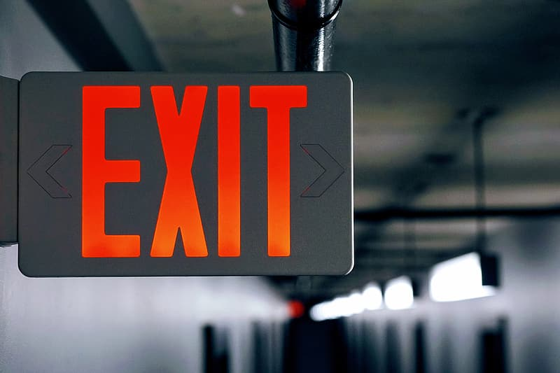
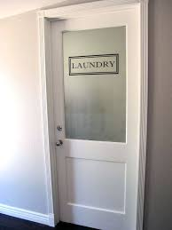
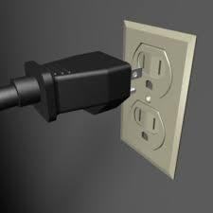
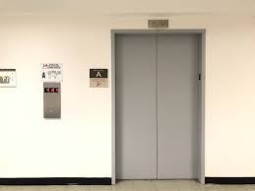
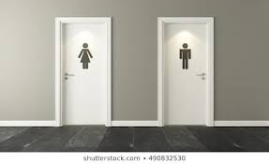
Experimental Results
Five classes of objects chosen to help visually impaired to navigate indoors:
door, restroom, elevator, outlet plug, exit sign
Notes:
We design the system to detect 5 classes of objects to help the visually impaired to navigate indoors. Door, restroom, elevator, outlet plug, exit sign. Next we will talk about the object detection model and some experimental results

Slide 10
Object detection model
Architecture: SSD w/MobileNet V2
During inference, export the trained model to Tensorflow-Lite to speed up mobile performance
12 common augmentations were used to improve accuracy
Random horizontal flip
SSD random crop
Random black patches
Random pixel value scale
Random rgb to gray
Random adjust brightness
Random adjust contrast
Random adjust hue
Random adjust saturation
Random distort color
Random jitter boxes
Auto-augment image
Sandler, M., Howard, A.G., Zhu, M., Zhmoginov, A., Chen, L.: Inverted residuals and linear bottlenecks: Mobile networks for classification, detection and segmentation. CoRR abs/1801.04381 (2018)
Notes:
We decided to choose single-shot detection with mobilenet v2 as the backbone for its fast inference potential and acceptable accuracy. During inference, we export the trained tensorflow model to Tensorflow-Lite to speed up performance on mobile phones. We also perform 12 common augmentations to improve the accuracy and generalization ability of the model.

Slide 11
Training Data
Need rectilinearized 360° pictures, but cannot find any publicly available dataset
Manually collected 360° pictures, rectilinearize them, and annotate using LabelImg
We took 300 360° images in three buildings, and after rectilinearization with openMP and pruning, 518 images 2688 x 1344 are used for training. The FoV of each rectilinearized image is 90°.
Tzutalin: LabelImg (2015)
Moulon, P., Monasse, P., Perrot, R., Marlet, R.: Openmvg: Open multiple view geometry pp. 60–74 (2016)

Slide 12
Accuracy: precision and recall
Same: Test pictures are from the same building as training data (Cory Hall, Soda Hall, SDJ Hall)
Different: Test pictures are from a different building from the training data (Stanley Hall).
Notes:
Here we categorize the performance of the model with precision and recall. Same means that Test pictures are from the same building as training data, and
Different means that Test pictures are from a different building from the training data. We can see that from the table that the model shows some generalization capabilities, which can be improved by incorporating more buildings into the training data. The biggest drop In performance come from bathrooms and plugs, the reason being that the training data comes from different buildings, which has vastly different construction styles with the color, shape and model of the signs, doors, and plugs.

Slide 13
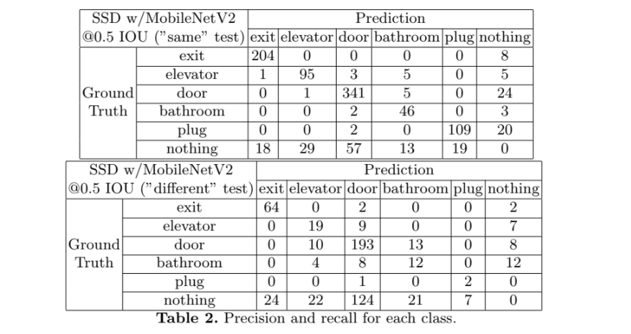
Confusion Matrices:
Total
212
109
366
51
131
Total
68
36
224
36
3
Notes:
Here we see the confusion matrices of the two tests, and we can see that the poor performance in for example, the plug of the different test, is simply due to us not having enough manpower to collect the data.

Slide 14
Augmentations improve performance
More data augmentations improve the generalization capability of the model
Why not better backbone?
Slow inference for negligible MAP gain in generalized tests
Notes:
(Each time you explain a bullet in the text, use your pointer in the table to show the numbers that JUSTIFY that bullet you are talking about)
One thing to note is that augmentations improve the generalization capability of the model. Also, the reason why we did not use a better backbone is that inference is much slower for negligible MAP gain in generalized tests. ResNet-50 FPN is used as the better backbone context. We can see at 12 augmentations it performs slightly better than MobileNet, but it is vastly slower at inference time. Next we will take a look at some of the detection examples

Slide 15
Example Detections
Notes:
Here are some examples for the 360 detection

Slide 16
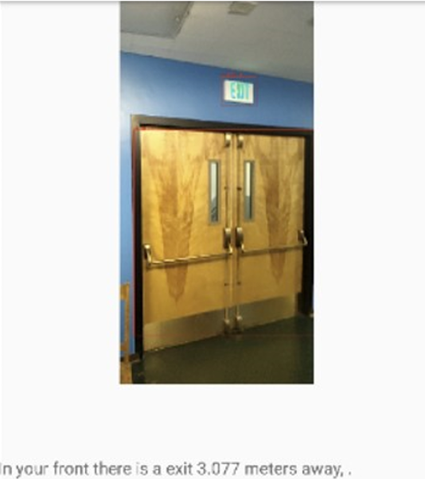
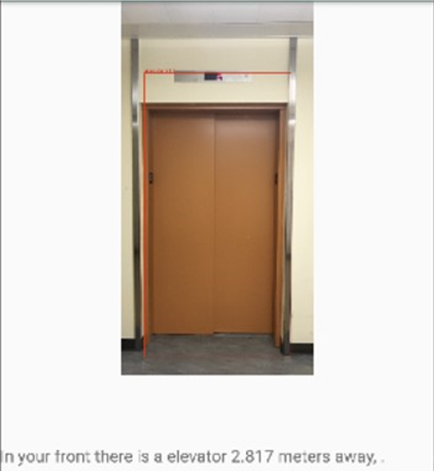
Detection Examples with a Depth Enabled Smartphone
There is an exit in front of you at 3 meters away
There is an Elevator in front of you at 2.8 meters away
Notes:
Here are some examples for depth detection. The detections have red box around them, for the exit it’s a bit hard to see, but it’s there

Slide 17
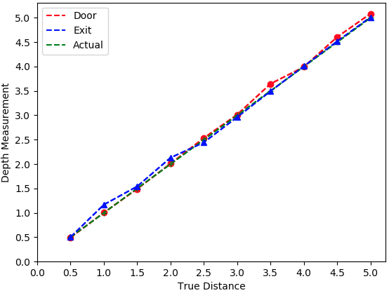
Distance Estimation Accuracy
Notes:
Here is a plot for the accuracy of the depth measured by the depth camera verses the true distance up to a range of 5 meters. The X axis is the true distance of the objects from the user and the y axis is the depth measurement. As you can see, it is very accurate.

Slide 18
Future Work
Improve generalization capability of the model
Better yet fast architectures
More style variance in dataset
Close the gap between “Same” and “Different”
Hardware design improvements
360 camera too conspicuous with protrusions above the head of the user
Use a retractable rod to make the 360 go up and down on demand
Need to be careful not to hit door tops in entering and leaving rooms
Conduct more user studies for better understanding of ergonomics needs
Notes:
Future work involves Improving generalization capability of the model, Hardware design improvements and more user studies
For the model we need
More style variance in dataset and perhaps Better yet fast architectures and to Close the gap between “Same” and “Different”
As for the hardware design, currently the 360 camera too conspicuous with protrusions above the head of the user, so we would like Use a retractable rod to make the 360 go up and down on demand, we also need to be careful not to hit door tops in entering and leaving rooms
Lastly, more user studies needs to be done to understand the ergonomic needs of the target user better.

Slide 19
Acknowledgements
Thanks for Microsoft Accessibility grant at UC Berkeley for funding this project.
Notes:
We thank the Microsoft Accessibility grant at UC Berkeley for funding this project

