Slide 1
Techniques for Improved Speech-based Access to Diagrammatic Representations
Tomás Murillo-Morales and Klaus Miesenberger
Institute Integrated Study
Johannes Kepler University, Linz (Austria)

Slide 2
Index
Motivation
Natural Language Access to Graphics
Web Framework
Conclusions and Further Work

Slide 3
Index
Motivation
Natural Language Access to Graphics
Web Framework
Conclusions and Further Work

Slide 4
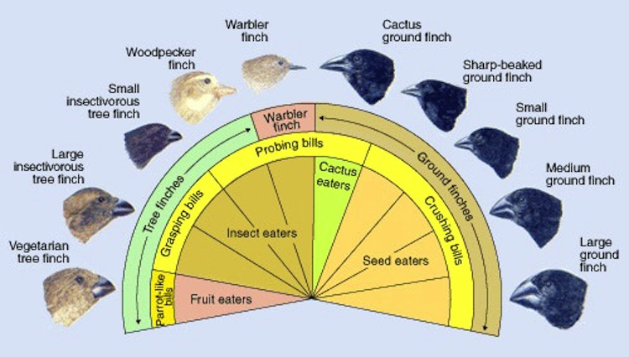
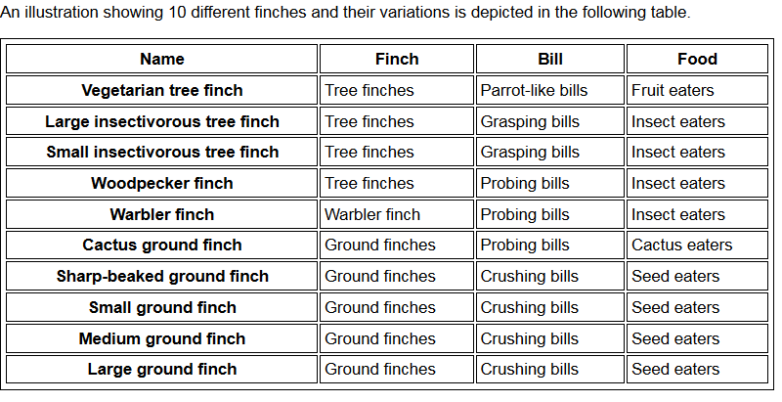
Motivation
Traditional approach to accessibility of Web graphics: textual descriptions and tabular equivalents
Short-term memory overload
Implicit information lost
No means for obtaining overview of the data
Source: http://ncamftp.wgbh.org/sp/tests/imagedesc

Slide 5
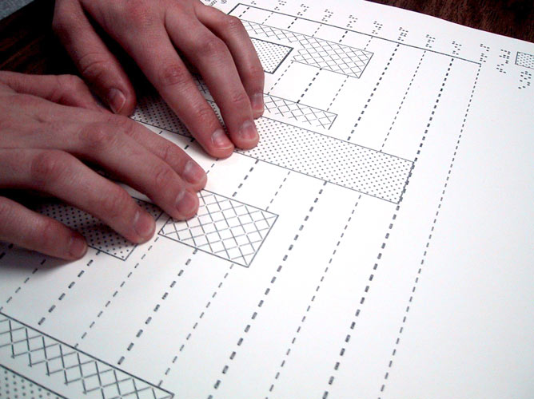
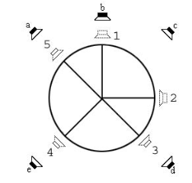
Motivation
Advanced Approaches:
Tactile Graphics
Hard-copies, surface haptic displays, lateral skin displacement displays, vibrotactile displays, bubble displays, force displays.
Sonification
Auditory icons, earcons, spearcons, data audification, spatial sound.
Interactive Approaches
Natural Language Interfaces, Interactive Interfaces.
Hybrid Approaches
Combine a number of other approaches.

Slide 6
Motivation
Take up of advanced methods is very limited:
Bulky, difficult to use and carry (hard copies, haptic displays)
Very limited applicability, difficult interpretation (graph sonification, automatic text summarization)
Low resolution or restricted display size, static (most haptic displays, hard-copies)
Non-autonomous, difficult to learn, expensive (most hybrid and tactile approaches)
Still in their infancy (bubble displays, other)
Most blind persons do not even attempt to read a tactile graphic!

Slide 7
Index
Motivation
Natural Language Access to Graphics
Web Framework
Conclusions and Further Work

Slide 8
Natural Language Access to Graphics
Common accessibility to diagrams: Natural Language Interface (NLI)
Natural Language can describe meaning and tasks at any level of abstraction.
Many cognitive advantages of diagrammatic representations may be compensated in a NLI by using summarizing and annotation techniques.
Purely Web-based, accessible: users are not required to learn new methods or technologies, intuitive, cheap, no extra hardware required.
Information may be not only fetched, but also modified: users can add personal annotations and navigate the graphic

Slide 9
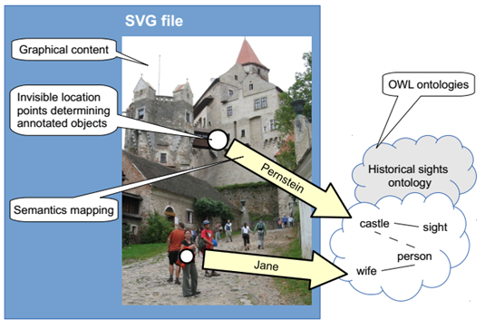
Natural Language Access to Graphics
Communicative Images (Plhák, 2014)
Two-dimensional objects (graphics) + dialogue interface + knowledge database (ontologies).
Domain knowledge is decoupled from linguistic features.
Focus on real-world images only (diagrams left out)

Slide 10
Index
Motivation
Natural Language Access to Graphics
Web Framework
Conclusions and Further Work

Slide 11
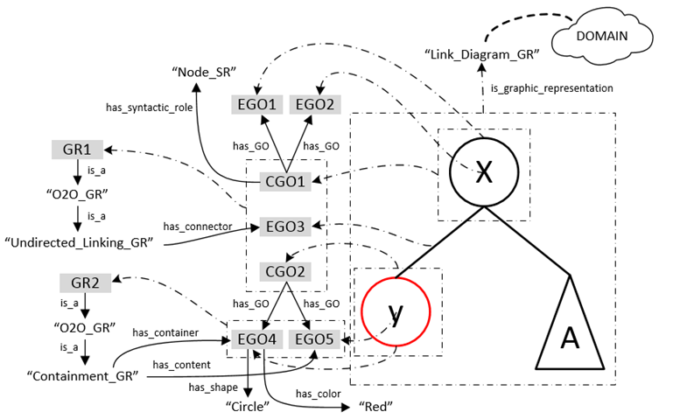
Web Framework
Semantics are given to a diagram via ontologies:

Slide 12
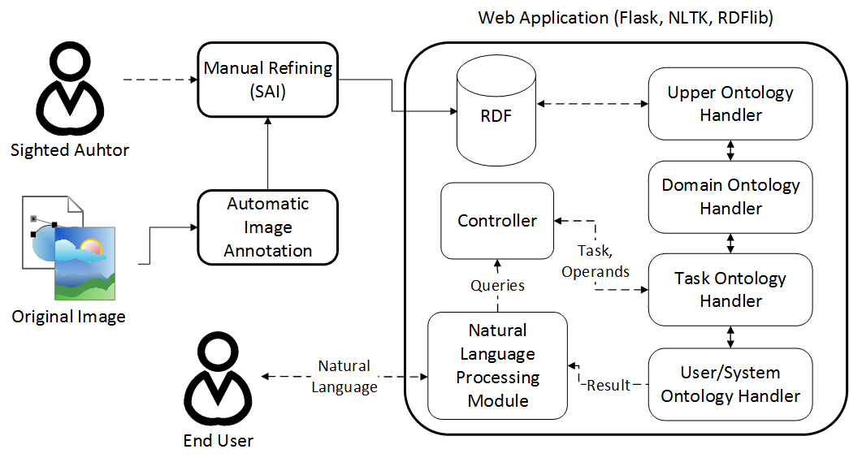
Web Framework
Ontologies are loaded and handled through a NLI:

Slide 13
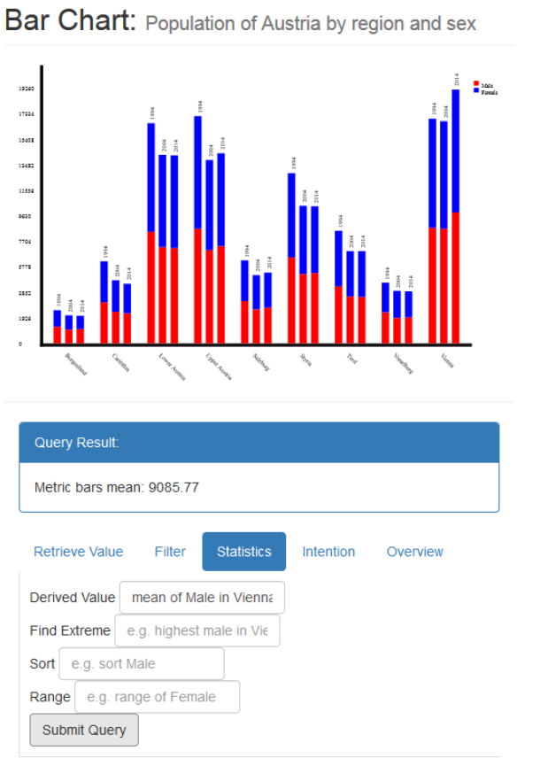
Web Framework
Tasks are displayed and grouped according to the domain of the graphic
Task examples: compute derived value (e.g. mean, arithmetic operations), find extremes, sort values, filter.
An overview is automatically computed and presented first to give the user a broad overview before delving into details

Slide 14
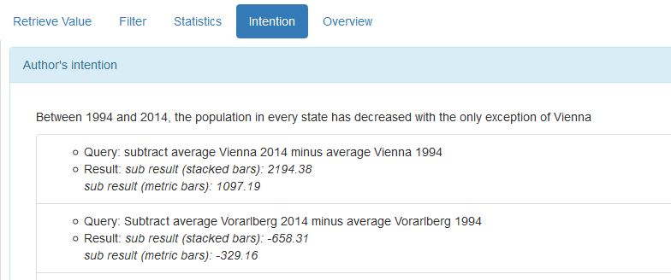
Web Framework
Other techniques employed to compensate for loss of sight:
Author’s intention: tasks can be marked at the task ontology level to create high-level tasks that are highlighted in the user interface

Slide 15
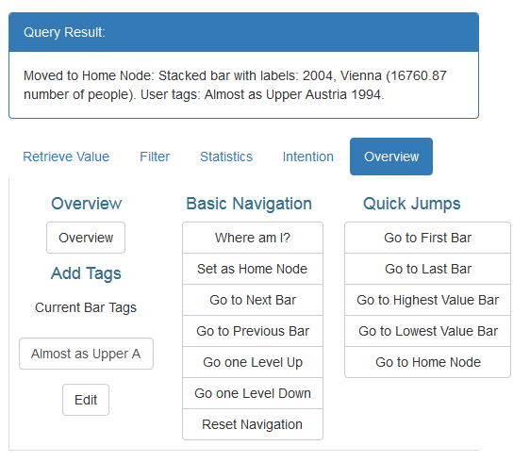
Web Framework
Navigation shortcuts: user may navigate through the chart element by element, or jump to elements having special characteristics e.g. highest value, first position
Personal annotations: each element might be given a textual annotation. When output, its annotations are shown
Home node: an element can be assigned as the home node for easier comparison of other elements with respect to it

Slide 16
Index
Motivation
Natural Language Access to Graphics
Web Framework
Conclusions and Further Work

Slide 17
Conclusions and Further Work
Natural Language (NL) has the potential of allowing blind persons to autonomously access graphics on the Web, including statistical charts
Our prototype allows blind persons to perform common analytical tasks on bar charts, supporting them with several techniques to compensate for the lack of sight
Further work:
Increase supported domains (link diagrams, maps…)
Integrate automatic image annotation and segmentation techniques
Improve natural language understanding

Slide 18
Questions?

Slide 19
Thank you!

