Slide 1
Learning through videos: Are Disabled Students using good Note-taking Strategies?
Abi James, E.A. Draffan & Mike Wald
WAIS, ECS
University of Southampton, UK

Slide 2
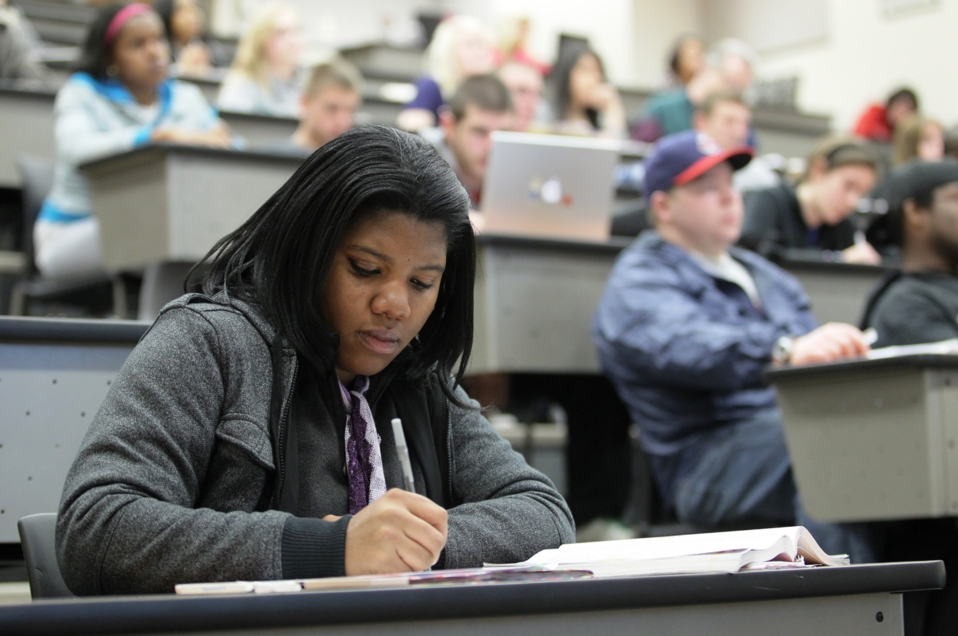
Importance of note-taking while studying
Student grades are related to the quality of their notes [1]

Slide 3
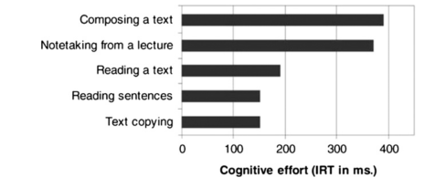
Real-time note-taking is cognitively demanding
Students working memory ability predicted the quality of hand-written notes [2]
Note-taking can be more cognitively demanding than other study tasks [3]
Notes:
students working memory ability predicted the quality of hand-written notes [2]
Note-taking can be the more cognitively demanding than other study tasks [3]

Slide 4
Barriers to note-taking
Note-taking is one of the most commonly supported areas for UK disabled students [4]
Capturing notes electronically may impact on their effectiveness [5]
Notes:
65%+ of disabled students use audio recordings to support note-taking
Notetaking is a multisensory process - technology or human support is required for students with sensory barriers
Technology to physically capture notes still limited e.g. maths & diagrams

Slide 5
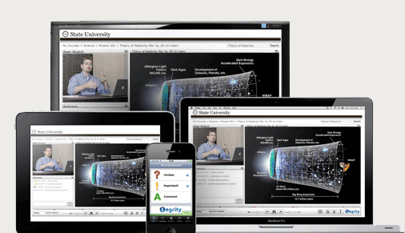
Multimedia e-learning
Multimedia & video are used in many different teaching approaches
Informal learning (e.g. software tutorials)
Open courseware platforms (e.g. SlideWiki)
MOOCs (e.g. FutureLearn)
Distance learning courses (e.g. OU)
Lecture capture
Flipped classroom
Multimedia activities

Slide 6
Multimedia e-learning (2)
Accessibility standards starting to consider barriers to understanding video content [6] e.g.
changing the speed of videos
synchronising video to the speed at which the user reads the captions
Short videos can be more effective for learning
2-10 minutes reported to be ideal length
Notes:
Videos often reported to support disabled students but there is limited evidence except for assisting those unable to attend sessions [7, 8]
Dyslexic students:
use lecture capture recordings more, listen to them for longer but no significant impact academic performance [9]
Revising from textbooks was more effective than lecture capture. Both more effective that using own notes [10]

Slide 7
Disabled learners & videos
Videos often reported to support disabled students, but there is limited evidence except for helping those absent students [7, 8]
Dyslexic students:
use lecture capture recordings more; listen to them for longer; but found to be no significant impact on academic performance [9]
Revising from textbooks was more effective than lecture capture. Both more effective than using own notes [10]

Slide 8
Disabled students note-taking preferences - remaining questions:
Does learning through videos support or hinder disabled students learning strategies?
Are disabled students equipped with the strategies & technologies to learn from videos?
Initial survey of staff & students in UK universities to understand current approach
120 respondents (60 staff, 60 students) between April – June 2015

Slide 9
Self-reported confidence in note-taking abilities
56% of students report moderate, low or no confidence in their note-taking abilities (compared to 13% of staff)

Slide 10
How effective are these note-taking strategies?
Notes:
Students choosing to use strategies that they felt were not effective
Effectiveness measured on a 5-point Likert scale

Slide 11
University provision support: recordings & lecture capture
26% of students have received video recordings
Most likely to access on a laptop at home
All students rated this as an effective strategy
Most likely to receive slides synced with audio
Very few students had access to captions or transcript (including hearing impaired students)

Slide 12
Students Comments on video use
“Very useful as you can pause it…However this can be quite time consuming.”
“It is helpful sometimes to look at the explanation again but it is too time consuming to watch it all again notes are better ”
“The effectiveness of video very much depends on the production quality. Clear audio, in focus speaker, close enough to make out etc.”

Slide 13
Concerns about audio/video capture
“I feel that the note-taking resources available to me are useful …however this can make note taking more time consuming … I wouldn't watch the lecture all over again to make better notes”
“Not helpful in the way that it takes a long time to go through if you have lots of contact hours, however useful if you only need to rehear parts of the lecture.”

Slide 14
Many note-taking apps and technologies available but…
Few tools for note-taking from videos or barriers experienced by for disabled students.
Note-taking Apps Mind Map courtesy LearningInHand.com
Notes:
Plethora of note taking tools now available
But most do not provide

Slide 15
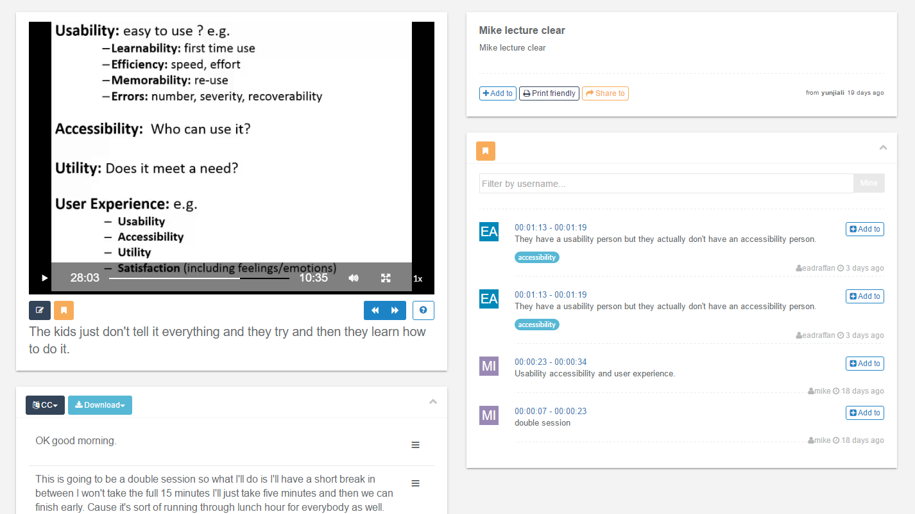
Tools on the students’ horizon
Bookmarking within video transcripts e.g. Synote.com
Embedding videos & screenshots in notes apps e.g. Audio Notetaker
Personalised playlist of video snippets

Slide 16
Conclusion
Note-taking remains an important part of learning
Use of videos are becoming more prevalent but students’ strategies and tools are not always appropriate
Disabled students show a preference for visual/graphical note-taking tools
Developers should consider how to provide accessible and visual tools specifically for working with videos

Slide 17
Thank You
Abi James
a.james@soton.ac.uk

Slide 18
References
[1] Kiewra, K.A.: Investigating notetaking and review: a depth of processing alternative. Educ. Psychol. 20(1), 23–32 (1985)
[2] Bui, D.C., Myerson, J.: The role of working memory abilities in lecture note-taking. Learn. Individ. Differ. 33, 12–22 (2014)
[3] Piolat, A., Olive, T., Kellogg, R.T.: Cognitive effort during note taking. Appl. Cogn. Psychol. 19(3), 291–312 (2005)
[4] Dept Business, Innovation & Skills: Disabled Students’ Allowances Consultation: Equality Analysis (2014)
[5] Bui, D.C., Myerson, J., Hale, S.: Note-taking with computers: exploring alternative strategies for improved recall. J. Educ. Psychol. 105(2), 299 (2013)
[6] W3C: Media Accessibility User Requirements http://w3c.github.io/pfwg/media-accessibility-reqs/#cognitive-disabilities (2015)
[7] Vajoczki, S., Watt, S., Fenton, N., Tarkowski, J., Voros, G., Vine, M.M.: Lecture capture: an effective tool for universal instructional design? Can. J. High. Educ. 44(2), 1–29 (2014)
[8] Burgstahler, S.: Opening doors or slamming them shut? online learning practices and students with disabilities. Soc. Incl. 3(6) (2015)
[9] Leadbeater, W., Shuttleworth, T., Couperthwaite, J., Nightingale, K.P.: Evaluating the use and impact of lecture recording in undergraduates: evidence for distinct approaches by different groups of students. Comput. Educ. 61, 185–192 (2013)
[10] Leadbeater, W., Anderson, V., Onens, S., Nightingale, K.P.: Supplementary lecture recording. A stepping stone to inclusion? In: Presentation to the ADSHE Conference, June 2014 (2014)

