Slide 1
15th International Conference on Computers Helping People with Special Needs
Optimizing Vocabulary Modeling for
Dysarthric Speech Recognition
July 15, 2016
Minsoo Na¹ and Minhwa Chung^{1,2}
¹Interdisciplinary Program in Cognitive Science, Seoul National University
²Department of Linguistics, Seoul National University

Slide 2
Contents
Introduction: Motivation, Research Issues
Related Works for VUI with Dysarthric Speech Recognition
Problem Definition of Vocabulary Modeling
Classification of Phonemes
Data Analysis
Experiments and Results
Conclusions

Slide 3
Motivation
Dysarthria is a motor speech disorder caused by damage to the central or peripheral nervous system.
People with dysarthria have difficulties in operating IT devices using hands because of physical limitations caused by neurological deficits.
Automatic Speech Recognition can provides an alternative interface.
low physical exhaustion and less time consuming effort
low speech recognition accuracy
Our goal is to develop a Voice User Interface for Koreans with dysarthria, which can run on various products such as smartphones, tablet PCs, mobile devices, and etc.
Notes:
Dysarthria is a motor speech disorder caused by damage to the central or peripheral nervous system.
Physical limitations due to neurological deficits make it difficult for people with dysarthria to operate IT devices using hands.
In this sense, automatic speech recognition can provides an alternative interface.
If it works successfully, there are many advantages, such as low physical exhaustion and less time consuming effort.
However, the problem is speech recognition accuracy is too low to be practical in many cases which are now in everyday use for people without dysarthria.
Our goal is to develop a Voice User Interface for Koreans with dysarthria. The system can run on various products such as smartphones, tablet PCs, mobile devices, and so on.

Slide 4
Typical Architecture of Automatic Speech Recognition System
Signal Processing Frontend
Search Engine
Recognized
Text
Speech Input
Noise
Processing
Feature
Extraction
Feature
Vector
Sequence
Application
Software
System
Action
Decoder
Acoustic
Model
Pronunciation
Dictionary
Language
Model
Knowledge
Speech ⇔ Phone
Phone ⇔ Word
Word ⇔ Sentence
Notes:
This figure shows a typical architecture of automatic speech recognition system.
Signal processing front-end handles noise in the speech input and extract features for pattern recognition.
Knowledge about speech is modeled by acoustic, pronunciation, and language models.
Acoustics model explains the statistical relationship between speech signal and phone. This probabilistic model is obtained by Gaussian Mixture Modeling in Hidden Markov Models or by Deep Neural Networks.
Pronunciation model explains the relationship between phone sequences and word in pronunciation dictionary. It also includes the issue of vocabulary modeling.
Language model explains the statistical relationship between word and sentence.
The search engine uses knowledge represented by these models in decoding feature vector sequences to produce a recognized text.
Application software interprets the recognized text and produces the corresponding system action.

Slide 5
Main Research Issues for VUI with Dysarthric Speech Recognition
Improve Usability
Speech Input
Search Engine
Recognized
Text
Noise
Processing
Feature
Extraction
Application
Software
System
Action
Decoder
Increase Accuracy
Reduce WER(Word Error Rate)
Acoustic
Model
Pronunciation
Dictionary
Language
Model
Speech ⇔ Phone
Phone ⇔ Word
Word ⇔ Sentence
Notes:
There are two big research issues for Voice User Interface with dysarthric speech recognition
At first, since the dysarthric speech recognition accuracy is too bad, we have to somehow increase the accuracy good enough for practical applications, or in other words, to reduce word error rate.
This issue is related with modules in the yellow part.
Secondly, although low speech recognition performance is unavoidable, we can make the voice user interface more practical by improving usability of the application software.
Of course, these two efforts should be taken together to make dysarthric Voice User Interface.

Slide 6
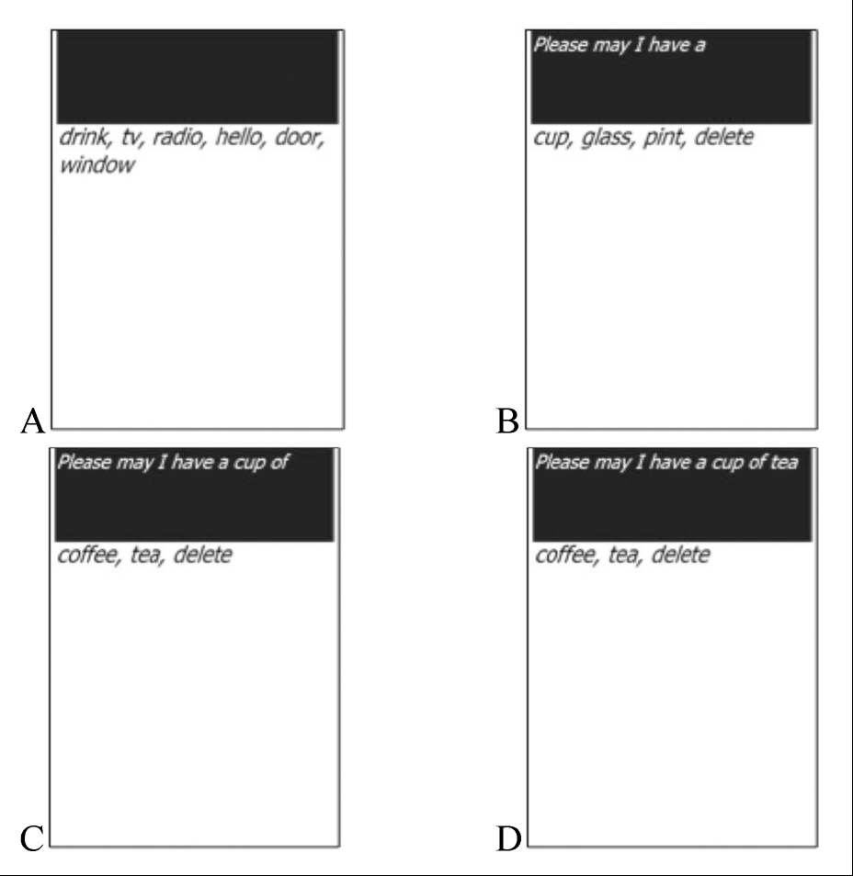
Related Works for VUI with Dysarthric Speech Recognition
Improving usability in Application SW
VIVOCA (Voice-Input Voice-Output Communication Aid) in [4] recognizes the disordered speech of the user and builds messages, which are converted into synthetic speech.
The example sentence “Please may I have a cup of tea” is written in the panel by the message building interface recognizing 3 word utterances “drink, cup, tea”.
Notes:
As for improving usability in application software, the Voice-Input Voice-Output Communication Aid in [4] shows a good example.
VIVOCA recognizes the disordered speech of the user and builds messages, which are converted into synthetic speech.
The example sentence “Please may I have a cup of tea” is written in the panel by the message building interface recognizing 3 word utterances “drink, cup, tea”.

Slide 7
Related Works for VUI with Dysarthric Speech Recognition
LVCSR(Large Vocabulary Continuous Speech Recognition) is not affordable to dysarthric speech recognition due to high WER.
The applications for dysarthric speakers need to constrain the structure of grammar of the user utterance and the number of words in the vocabulary.
Language Modeling
Reduce the perplexity to lower the WER [4][5][6]
With small-sized vocabulary, Isolated Word Recognition or Simple Patterned Grammar Recognition
Vocabulary Modeling in Pronunciation Dictionary
Voice keyboard [5][6]
The words which lower the WER are selected for command words for voice keyboard input.
Notes:
Large Vocabulary Continuous Speech Recognition is not affordable to dysarthric speech recognition due to high Word Error Rate.
So, the applications for dysarthric speakers need to constrain the structure of grammar of the user utterance and the number of words in the vocabulary.
In papers [4], [5], and [6], to reduce the perplexity of language model to lower the word error rate, with small sized-vocabulary, Isolated Word Recognition or Simple Patterned Grammar Recognition is suggested.
Vocabulary modeling for voice keyboard is the topic of our research in this presentation.
In papers [5] and [6], the words which lower the word error rates are selected for command words for voice keyboard input.
I will describe these works in details.

Slide 8
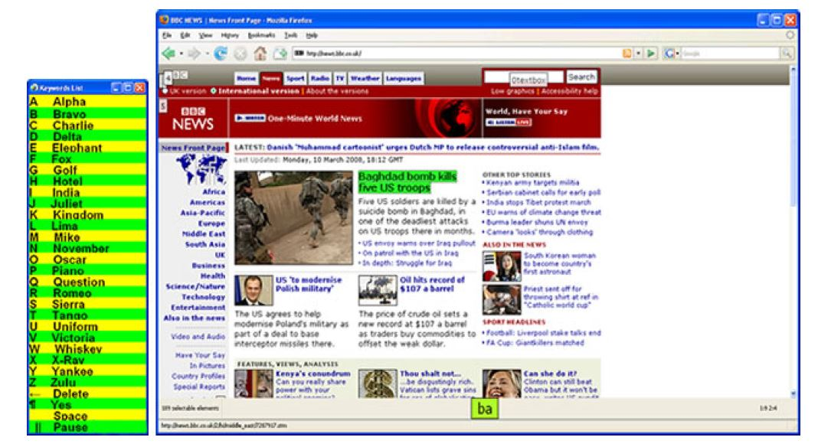
Related Works for VUI with Dysarthric Speech Recognition
Voice Keyboard in CanSpeak [6]
Voice keyboard interface is used to input graphemes and a set of commands to control.
Word list
and
Webspeech
interface of
CanSpeak
Notes:
Hamidi proposed CanSpeak, where voice keyboard interface is used to map input graphemes with a set of keyword commands.
For example, say keyword “Alpha” to input a grapheme “a”.
The list of keywords is customized to each user.

Slide 9
Related Works for VUI with Dysarthric Speech Recognition
Voice Keyboard in CanSpeak [6] in 2010
Customizing the vocabulary for each individual by
Recognizing the speech of each dysarthric individual
Analyzing by an experimenter
Identify problem words
Interviewing the subject
Customizing keywords
The results of the customizing is not applicable to other dysarthric users.
The customization procedure has to be performed for every new user.
Notes:
The vocabulary is customized for each individual by following this procedure.
Recognize the speech of each dysarthric individual.
Using the analysis of speech recognition results, identify the problem words.
By interviewing the subject, customize keywords, which can improve the recognition of problem words.
The results of the customizing is not applicable to other users.
That is, the customization procedure has to be performed for every new user.

Slide 10
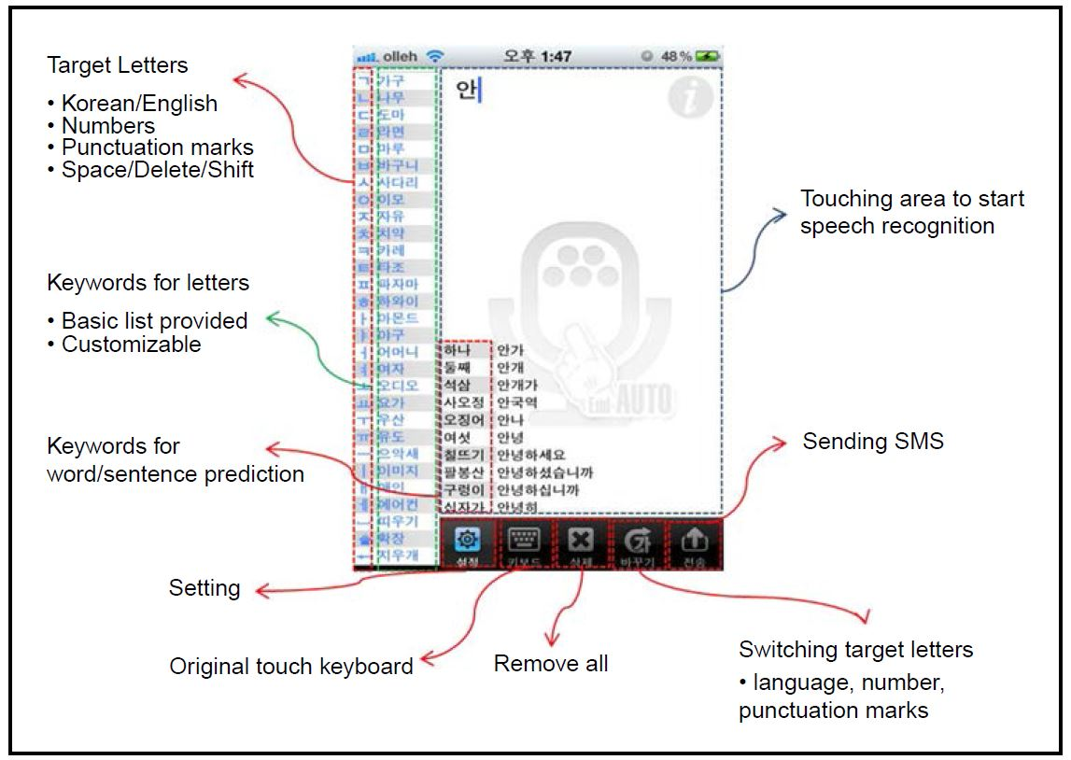
Related Works for VUI with Dysarthric Speech Recognition
Voice Keyboard used for VUI for Korean dysarthric speakers [5] in 2013
Notes:
Our research team also made a voice keyboard for mobile devices and PCs.
It uses an isolated word recognition engine with a word prediction function for texting.
Target users are Korean dysarthric speakers.
Target letters include Korean and English graphemes, numbers, punctuation marks and some keys useful for editing text.

Slide 11
Related Works for VUI with Dysarthric Speech Recognition
Voice Keyboard used for VUI for Korean dysarthric speakers [5] in 2013
The keywords in the vocabulary are composed by the phonetic alphabets designed for Korean dysarthric users.
Ease of articulation is the criterion to select the keywords to minimize the articulation error.
“가구” for “ㄱ”, “나무” for “ㄴ”
The criterion is judged by human listening, so the result of speech recognition might be different.
Notes:
The keywords in the vocabulary are composed by the phonetic alphabets designed for Korean dysarthric users.
Ease of articulation is the criterion to select the keywords to minimize the articulation error.
Drawback is that results of human listening and of recognition can be different.

Slide 12
Problem Definition: Vocabulary Modeling
Vocabulary modeling is to select the optimal keywords as the recognition words in the vocabulary of the speech recognizer.
We want to optimize vocabulary for VUI for Korean dysarthric speakers by selecting 47 keywords to reduce WER of voice keyboard application.
14 keywords for the Korean consonant graphemes
12 keywords for the Korean vowel graphemes
21 keywords for controlling mobile devices
Notes:
Vocabulary modeling means to select the optimal keywords as the recognition words in the vocabulary of the speech recognizer.
We want to optimize vocabulary for VUI for Korean dysarthric speakers by selecting 47 keywords to reduce WER of voice keyboard application.
47 keywords consist of 14 keywords for the Korean consonant graphemes, 12 keywords for the Korean vowel graphemes, and 21 keywords for controlling mobile devices.

Slide 13
Related Works on Articulation Errors for Dysarthric Speech
Research on articulation errors for dysarthric speech [7][8]
Error was more frequently observed in articulating consonants than in vowels.
For consonants, fricatives and affricates showed higher error rates when classified by manner of articulation and alveolar showed higher rate when classified by place of articulation.
For vowels, error rate for monophthongs at the extreme positions such as /i, ae, a/ were lower for English dysarthric speakers.
Listening by human and recognizing by machine
Intelligibility and recognition error rate are in inverse proportion.
The score of intelligibility of human rater is different from the recognition accuracy [9]
Observations from the previous researches
Articulation error of a phoneme is influenced by the phonetic classes.
Articulation affects the speech recognition results, however, the results of them do not match.
Notes:
From research on articulation errors for dysarthric speech and comparing listening by human and recognizing by machine, we observe that
articulation error of a phoneme is influenced by the phonetic classes,
and articulation affects the speech recognition results, however, the score of intelligibility of human rater is different from the recognition accuracy.

Slide 14
Our Approach and Research Goals
Our approach for vocabulary modeling
Recognize the dysarthric speech in the training set.
Predict the recognition results in terms of articulation of phonetic classes using a generalized linear mixed model.
Define the recognition score for each word based on the model, which is applicable to users who are not included in the training set.
Optimize the vocabulary by selecting the keywords which maximize the score and evaluate the optimization by speech recognition tests.
Research goal
Model the effect of articulation of phonetic classes on speech recognition correctness rather than on articulation accuracy.
Select recognition words to reduce speech recognition errors.
Notes:
Our approach to vocabulary modeling is
At first, recognize the dysarthric speech, predict the recognition result and define the recognition score.
Then optimize the vocabulary using the recognition score and evaluate the optimization by speech recognition tests.
Our research goals are to
model the effect of articulation of phonetic classes on speech recognition correctness rather than on articulation accuracy,
and select recognition words to reduce speech recognition errors.
These viewpoint has not been previous reported by related works.

Slide 15
Classification of Phonemes
20 Consonants in Korean
Classification of the consonants by
Manner of articulation
Place of articulation
 |  | Place
 |  | Labial | Dental | Palatal | Velar | Glottal
Manner | Plosive | p, pʰ, p⁼ | t, tʰ, t⁼ |  | k, kʰ, k⁼
 | Affricate |  |  | ʨ, ʨʰ, ʨ⁼
 | Fricative |  | s, s⁼ |  |  | h
 | Nasal | m | n |  | ŋ
 | Lateral |  | l, ɾ
Notes:
We define 20 consonants in Korean as in this table.
Consonants are classified by the manner of articulation and by the place of articulation.

Slide 16
Classification of Phonemes
Vowels in Korean
8 monophthong
12 diphthongs
 |  | Frontness
 |  | Front | Central | Back
Height | High | i |  | ɯ, u
 | Mid-High | e |  | o
 | Mid-Low | ɛ |  | ʌ
 | Low |  | a
 | /j/-class | /w/-class | /ɰ/-class
Diphthong | je | ɥi | ɰi
 | jɛ | we
 | ja | wɛ
 | jo | wa
 | ju | wʌ
 | jʌ
Notes:
We define 8 monophthongs and 12 diphthongs in Korean as in these tables.

Slide 17
Classification of Phonemes
The AICs of the model built by classifying the diphthongs into the sub-classes were higher than the AIC of the model merging the diphthongs in one variable.
As a result, a vowel is firstly classified as a diphthong or a monophthong.
Secondly if the vowel is a diphthong, the phone is assigned to the diphthong class.
Or if the vowel is a monophthong, the phone is classified by the place of tongue and the height of tongue as in the previous tables.
Classification of the vowel
Place of tongue & Diphthong
Height of tongue & Diphthong
Notes:
The AICs of the model built by classifying the diphthongs into the sub-classes were higher than the AIC of the model merging the diphthongs in one variable.
As a result, a vowel is firstly classified as a diphthong or a monophthong.
Secondly if the vowel is a diphthong, the phone is assigned to the diphthong class.
Or if the vowel is a monophthong, the phone is classified by the place of tongue and the height of tongue as in the table 2, 3.
So, the classification of vowels is judged by Place of tongue & Diphthong and Height of tongue & Diphthong.

Slide 18
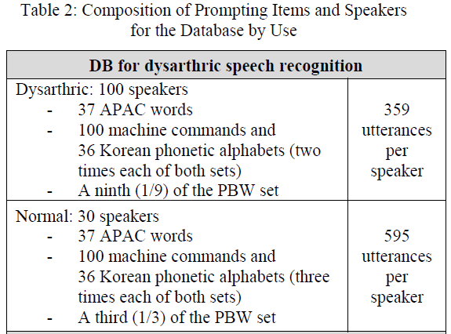
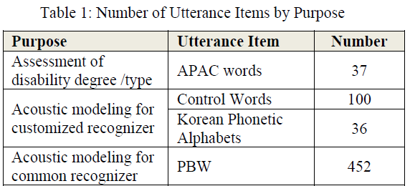
Data Analysis
Speech corpus
Data for analysis
173 words / 1 set (Table 1 in [10])
APAC words, Control words and Korean Phonetic Alphabets
2 sets of utterances / 1 dysarthric speaker
13 dysarthric speakers (Table 2 in [10])
Notes:
The speech corpus for analysis is composed of utterances from 13 dysarthric speakers in Table 2.
The utterances for each speaker consist of 2 sets of utterances and each set is composed of the utterance of 173 words in Table 1.

Slide 19
Data Analysis
Speech corpus
Data for the vocabulary modeling experiments
500 words / 1 set
105 words for device control
3 sets of 36 phonetic alphabet words (108 words)
287 words for phonetic balance
2 sets of utterances / 1 dysarthric speaker
13 dysarthric speakers
Notes:
The speech corpus for the vocabulary modeling experiments is composed of utterances from 13 dysarthric speakers.
Utterances for each speaker consist of 2 sets of utterances and each set is composed of the utterance of 500 words.
173 words in the corpus for analysis and 500 words in the corpus for vocabulary modeling do not overlap.
Because the 13 speakers in the 2 corpora are the same, the data for training and testing are folded by 2 parts for the speaker in the training set not participating in the testing set. That is, 2-fold cross validation is used.

Slide 20
Data Analysis
Dysarthric speech recognition
Kaldi toolkit [11] is used for speech recognition experiment.
Feature extraction
13-d MFCC feature / 1 frame
40-d feature from 13*7 features by linear discriminant analysis
Acoustic modeling
Training data = data for analysis, set 1
FMLLR feature transform, GMM model, MAP adaptation
Pronunciation model
Vocabulary size: 1,152 words
Average number of pronunciation variants: 1.1
Isolated word recognition
Notes:
Kaldi toolkit is used for isolated word speech recognition.
Parameters for feature extraction, acoustic modeling, pronunciation modeling are described here.
Feature extraction:
13-dimension MFCC feature is extracted per 1 frame
40-dim features are selected by LDA from 13*7 features
Acoustic modeling:
one set of 173 utterances of data for analysis is used for GMM-based acoustic model training (Gaussian Mixture Model)
FMLLR feature transform ( an unsupervised adaptation method) is extracted from the test set
GMM model is adapted per each speaker by applying the MAP method (Maximum A Posteriori adaptation)
Pronunciation modeling:
The vocabulary for training and testing consists of 1,152 words and 1,267 pronunciations. (average number of pronunciation variants = 1.1)
Isolated word recognition is performed: in the recognition, it is assumed that each utterance consists of only one word.

Slide 21
Data Analysis
Analysis on the effect of articulation on the WER
Generalized linear mixed model
Correctness ~ fixed effects + random effects
Fixed effects: Severity, Number of phones in the phonetic class
Random effects: word, speaker
Consonant | Vowel | Model Expression
Place | Height | correctness ~ (1|word) + (1|speaker) + severity + labial + dental + palatal + velar + glottal + high + mid-high + mid-low + low + diphthong
 | Frontness | correctness ~ (1|word) + (1|speaker) + severity + labial + dental + palatal + velar + glottal + frontal + central + back + diphthong
Manner | Height | correctness ~ (1|word) + (1|speaker) + severity + plosive + affricate + fricative + nasal + lateral + high + mid-high + mid-low + low + diphthong
 | Frontness | correctness ~ (1|word) + (1|speaker) + severity + plosive + affricate + fricative + nasal + lateral + frontal + central + back + diphthong
Notes:
The recognition correctness of each word is predicted in terms of fixed and random effects.
The fixed effects are composed of Severity and Numbers of phones in the phonetic classes.
The random effects are composed of word and speaker.
As the consonants are classified by the 2 criteria, Place and Manner, and the vowels are classified by the 2 criteria, Height and Frontness, we define 4 expressions to model the correctness.

Slide 22
Data Analysis
Example
Speaker = M0013
Severity = 2 (1: mild ~ 4: severe)
Word = “포도”, canonical pronunciation = “pʰ o t o”, “포도”
Recognized as “포도” → Correctness = 1
Number of phones = “pʰ:1, o:2, t:1”
Number of consonant class = “labial:1, dental:1, plosive:2”
Number of vowel class = “mid-high: 2, back: 2”
Intended Word | “포도”
↓ | ↓
Canonical Pronunciation | [pʰ o t o]
↓ | ↓
Value of Effects | Recognized as = “포도”, Correctness = 1, word = AP0001, speaker = M0013, severity = 2, labial = 1, dental = 1, plosive = 2 mid-high = 2, back = 2
Notes:
The value of the effects in each expression is observed from the pronunciations and the recognition results.
For example, here, a speaker ‘M0013’ whose severity is measured as ‘2’ utters the Korean word ‘포도’ , whose id is ‘AP0001’ and the recognizer outputs the result as ‘포도’.
The correctness is assigned as ‘1’ because the utterance is correctly recognized.
The number of each phone is observed: “pʰ:1, o:2, t:1”
The number of consonant class is observed: “labial:1, dental:1, plosive:2”
The number of vowel class is observed: “mid-high: 2, back: 2”
From the observations, the value of the effects are assigned: Correctness=1, word=AP0001, speaker=M0013, severity=2, labial=1, dental=1, plosive=2, mid-high=2, back=2

Slide 23
Data Analysis
Model selection
Akaike Information Criterion (AIC)
$AIC=2k−2ln⁡(L)$, k = # of parameter, L = maximum of the likelihood function for the model
The Manner of Articulation – Place of Tongue model minimizes the negative log-likelihood and the size of the model, AIC.
Consonant | Vowel | AIC
Place | Height | 2276.8
 | Frontness | 2275.8
Manner | Height | 2269.0
 | Frontness | 2268.1
Notes:
The AIC of the Manner-Frontness (MF) model is lower than the AIC of the Manner-Height (MH) model, but the difference is relatively small than the difference of the Manner and the Place models.
The WER of the Manner-Frontness model and the Manner-Height model would be reported.

Slide 24
Data Analysis
Estimates of the Manner-Frontness model, Table 6
Fricative, Nasal, Front, Central, Back and Severity are significant (p<0.05).
Correctness decreases as Severity and the number of Fricative and Lateral increases.
Correctness increases as the number of Nasal, Plosive, Affricate, Diphthongs and monophthongs increases.
Factor | Estimate | Std. Error | z value | Pr(>|z|) | Sign.
Intercept | 3.9602 | 0.4725 | 8.3810 | 0.0000 | ***
Plosive | 0.0416 | 0.0799 | 0.5200 | 0.6029
Fricative | -0.2586 | 0.1103 | -2.3450 | 0.0190 | *
Affricate | 0.0328 | 0.1139 | 0.2880 | 0.7734
Nasal | 0.2007 | 0.0821 | 2.4450 | 0.0145 | *
Lateral | -0.0379 | 0.1376 | -0.2750 | 0.7832
Diphthong | 0.0829 | 0.1316 | 0.6290 | 0.5291
Front | 0.3563 | 0.0949 | 3.7530 | 0.0002 | ***
Central | 0.7971 | 0.1274 | 6.2580 | 0.0000 | ***
Back | 0.4375 | 0.1126 | 3.8850 | 0.0001 | ***
Severity | -1.5684 | 0.2137 | -7.3410 | 0.0000 | ***
 | Significance level: *** p<0.001, ** p<0.01, * p<0.05
Notes:
The estimates of each class(Plosive, Fricative, … and Severity) correspond to the effect of articulation of the class on the correctness in the recognition.
It means that adding a Nasal phone in a word increases the expected correctness by 0.2007.
Also adding a Fricative phone decreases the correctness by 0.2586.
From this table, we observe that
Fricative, Nasal, Front, Central, Back and Severity are significant (p<0.05).
Correctness decreases as Severity and the number of Fricative and Lateral increases.
Correctness increases as the number of Nasal, Plosive, Affricate, Diphthongs and monophthongs increases.

Slide 25
Experiments and Results
Experimental environments
Kaldi toolkit [11] is used for speech recognition experiment.
Feature extraction
13-d MFCC feature / 1 frame
40-d feature from 13*7 features by linear discriminant analysis
Acoustic modeling
Training data = data for analysis + data for vocabulary, set 1 → 2-fold
FMLLR feature transform, GMM model, MAP adaptation
Pronunciation model
Vocabulary size: 500 words
Average number of pronunciation variants: 1.1
Isolated word recognition
Word Error Rate, WER
$WER=\frac{Number of Misrecognized Utterances}{Number of Recognized Utterances}$
Notes:
The kaldi toolkit is used for speech recognition experiment.
Parameters for the experiments are shown here.
The word error rate is computed from the results of the recognition which means the rate of the misrecognized utterances.
Feature extraction:
13-dimension MFCC feature is extracted per 1 frame
40-dim features are selected by LDA from 13*7 features
Acoustic modeling:
one set of 500 utterances of data for analysis is used for GMM-based acoustic model training
FMLLR feature transform ( an unsupervised adaptation method) is extracted from the test set
GMM model is adapted per each speaker by applying the MAP method
Pronunciation modeling:
The vocabulary for training and testing is consist of 1,152 words and 1,267 pronunciations. (average number of pronunciation variants = 1.1)
Isolated word recognition is performed: in the recognition, it is assumed that each utterance is consist of only one word.

Slide 26

Experiments and Results
Recognition score
$Recognition Score\left({word}_{i}\right)=\sum_{phonetic class j}{{weight}_{j}∗({number of phones}_{j})}$
Vocabulary
Size: 47 words
Baseline
Phonetic alphabet
Maximum number of phones criterion
Minimum number of phones criterion
Random selection
Recognition score criterion
Notes:
Recognition score of a word is defined by sum of the weight (the effect value) by the number of phones over phonetic classes.
The number of words in the vocabulary for testing is 47 and the number of words in the corpus is 500. –
So, constructing vocabulary is to select 47 keywords out of 500 words.
We construct 4 kinds of vocabularies to be the baselines:
47 words having the maximum number of phones as their pronunciations (in our pilot experiments, the WER is in inverse proportional to the length of the word)
47 words having the minimum number of phones as their pronunciations (in our intuitions, severe speakers may be hard to speak long words.)
Randomly chosen 47 words
26 phonetic alphabets for graphemes and 21 commands for control functions. We construct 3 kinds of phonetic alphabet vocabularies because we have 3 kinds of phonetic alphabets in the corpus.
The performance of the vocabulary composed by selecting words with the maximum of the recognition score is evaluated by comparing with the performance of the baseline vocabularies.

Slide 27
Experiments and Results
Word lists
Alphabet | Phonetic Alphabet Sets |  |  | Maximum # of phonemes | Minimum # of phonemes | Manner -Height | Manner -Frontness
 | 1 | 2 | 3
ㄱ | 가구 | 고구마 | 가게 | 관광객 | 우유 | 간접적 | 간접적
ㄴ | 너구리 | 나라 | 노인 | 적극적 | 아이 | 나라 | 나라
ㄷ | 도마 | 다리 | 단어 | 본격적 | 오이 | 돛단배 | 등록증
ㄹ | 라면 | 라디오 | 라이터 | 철학적 | 예의 | 라이터 | 라디오
ㅁ | 마루 | 매미 | 모내기 | 학생증 | 여우 | 밑바닥 | 밑바닥
ㅂ | 바나나 | 바다 | 비타민 | 팔공산 | 샤워 | 바나나 | 바나나
ㅅ | 사다리 | 소리 | 소나기 | 집단적 | 새우 | 사나이 | 사나이
ㅇ | 아줌마 | 엄마 | 아내 | 간접적 | 야후 | 아줌마 | 아줌마
ㅈ | 자유 | 지우개 | 주머니 | 경복궁 | 어디 | 집단적 | 집단적
ㅊ | 치약 | 차표 | 차이 | 뒷골목 | 위치 | 철학적 | 철학적
ㅋ | 카레 | 카라멜 | 카드 | 식생활 | 아기 | 카라멜 | 카라멜
ㅌ | 타조 | 타잔 | 토마토 | 팔봉산 | 이모 | 토마토 | 토마토
ㅍ | 파자마 | 피자 | 파도 | 한평생 | 요일 | 파자마 | 파자마
ㅎ | 하와이 | 하마 | 호미 | 등록금 | 애인 | 하룻밤 | 하룻밤
Notes:
Word lists used for the experiments are shown here.

Slide 28
Experiments and Results
Results
Baseline vocabularies
The average WER of 100 trials of the random selection is 17.2%.
WERs using 3 alphabet word lists are 16.5~18.2%.
Using maximum of the number of phoneme as criterion for selecting words showed 16.8% and using minimum criterion showed 21.1%.
Differences between 4 baseline recognition results are not significant.
Vocabulary |  |  | Word Error Rate, % |  |  | Improvement
 |  |  | Severity 2 | Severity 3 | Severity 2/3
Baseline | Phonetic Words | Set 1 | 19.0 | 15.6 | 18.2 | -
 |  | Set 2 | 16.6 | 16.3 | 16.5
 |  | Set 3 | 16.4 | 22.7 | 17.8
 | Minimum # of phonemes |  | 21.4 | 19.8 | 21.1
 | Maximum # of phonemes |  | 15.1 | 22.3 | 16.8
 | Random selection |  | 16.8 | 18.5 | 17.2
Recognition Score (Manner-Height) |  |  | 12.2 | 13.5 | 12.5 | 4.0
Recognition Score (Manner-Frontness) |  |  | 13.7 | 14.2 | 13.8 | 2.7
Notes:
In these results, we observe
The average WER of 100 trials of the random selection is 17.2%
WERs using 3 alphabet word lists are 16.5~18.2%.
Using maximum of the number of phoneme as criterion for selecting words showed 16.8% and using minimum criterion showed 21.1%.
In the Severity 2 group, speakers have lower WER when they utter longer words.
In more severe group, speakers have lower WER when they utter shorter words.
Differences between 4 baseline recognition results are not significant.

Slide 29
Experiments and Results
Results
Maximizing Recognition Score
Using the MF model, 13.8% WER was obtained, which is 2.7% (relatively 16.4%) improvement compared to the baseline.
Using the MH model, 12.5% WER was obtained, which is 4.0% (relatively 24.2%) improvement compared to the baseline.
The improvements are statistically significant, p<0.05.
Notes:
Optimizing the vocabulary with the recognition scores show improvements compared to the baselines. (p<0.05)
- Using the MF model, 13.8% WER was obtained, which is 2.7% (relatively 16.4%) improvement.
- Using the MH model, 12.5% WER was obtained, which is 4.0% (relatively 24.2%) improvement.
The AIC of the MH model is higher than the AIC of the MF model but the WER of the MH is lower.
- 1)The AIC is a criterion for likelihood and the WER is a criterion for classification error.
- 2)The training data for the GLMM modeling and the testing data for the speech recognition do not overlap so the characteristics of two data could be partially different.
- Therefore the superiorities of the AIC and the WER of the MH model and the MF model do not match makes sense.
- In the language modeling, the lowest perplexity does not guarantee the lowest WER.

Slide 30
Conclusions
The effects of the articulation on the WER
Four sets of the articulation features for each word are defined and the relationship between the features and WERs is analyzed using a GLMM.
Among the models, the Manner-Frontness model is selected as the best one by the analysis.
Estimates of the GLMM are observed and applied to calculate the recognition score.
Correctness decreases as Severity and the number of Fricative and Lateral increases.
Correctness increases as the number of Nasal, Plosive, Affricate, Diphthongs and monophthongs increases.
Notes:
The effects of the articulation on the WER are:
Four sets of the articulation features for each word are defined and the relationship between the features and WERs is analyzed using a GLMM.
Among the models, the Manner-Frontness model is selected as the best one by the analysis.
Estimates of the GLMM are observed and applied to calculate the recognition score.
Correctness decreases as Severity and the number of Fricative and Lateral increases.
Correctness increases as the number of Nasal, Plosive, Affricate, Diphthongs and monophthongs increases.

Slide 31
Conclusions
The recognition error and the articulation error
The results from Table 1 that increasing the number of Fricative increases the recognition error rates and the number of Nasal increases the correctness are consistent with the analysis of the articulation errors of the English dysarthric speech.
The difference between monophthong and diphthong is also consistent.
The fortis phonemes which are complex to articulate seem to lower the estimate of Plosive.
Notes:
The results from Table 1 that increasing the number of Fricative increases the recognition error rates and the number of Nasal increases the correctness are consistent with the analysis of the articulation errors of the English dysarthric speech.
The difference between monophthong and diphthong is also consistent.
The fortis phonemes which are complex to articulate seem to lower the estimate of Plosive.
These results will be useful for designing a dysarthric speech recognition system and can be further extended to other language by the mapping between the class of the phoneme and other language.

Slide 32
Conclusions
Articulation accuracy
(Glide), Nasal, Stop > Fricative, Affricate, Liquid
Effect of the articulation on the recognition correctness
Nasal, Plosive(Stop) > Affricate, Lateral(Liquid), Fricative
Table 9. Articulation accuracy and effect on the recognition correctness
Research | Language | Accuracy in the articulation
Platt et al.(1980) | English | glide > nasal > stop > liquid > affricate > fricative
Kim et al.(2010) | English | glide > nasal > stop > liquid > fricative > affricate
Whitehill & Ciocca(2000) | Cantonese | nasal > plosive(stop) > liquid > affricate > fricative
Research | Language | Effect on the recognition correctness
This paper | Korean | nasal > plosive(stop) > affricate > lateral(liquid) > fricative
Notes:
Articulation accuracy
Nasal and plosive(stop) show lower articulation error rates than liquid, affricate and fricative.
Accuracy of affricate > accuracy of fricative [7][8]
Effect on the recognition correctness
In this paper, also the effects of nasal and plosive on the recognition correctness were higher than the effects of liquid, affricate and fricative.
But the differences between the values of plosive, affricate and lateral(liquid) were relatively small and the values were close to zero.
The fortis phonemes seem to lower the estimate of plosive.

Slide 33
Conclusions
Vocabulary modeling
The vocabulary is optimized with words having the maximum recognition score for voice keyboard interface and, as a result, the WER decreases by 16.4%, relatively.
Further study
The results would be extended to other language by the mapping between the class of the phoneme in Korean and other language.

Slide 34
Thank you!
Q & A

