Slide 1
Accessibility of Self-Service Terminals in Norway
andreas.cederbom@funka.com
Twitter: @cederbomarn

Slide 2
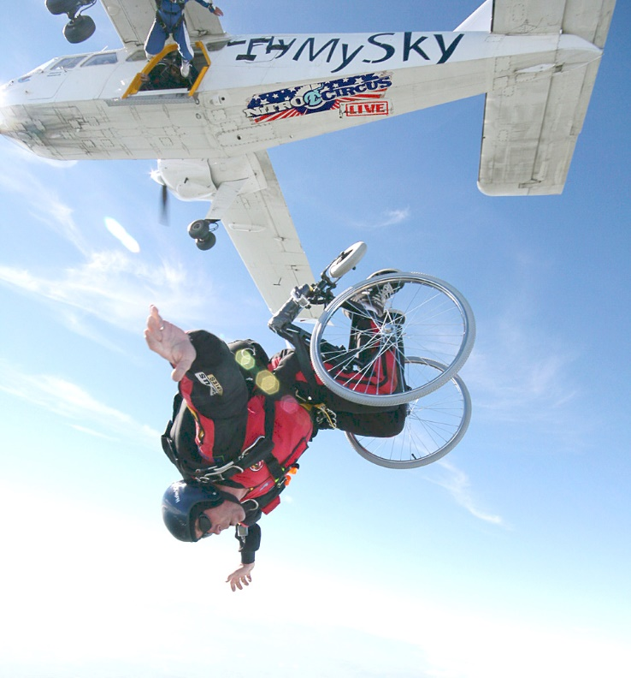
About Funka Nu AB
Founded by
Swedish disability organisations
Private company 2000
Oslo, Norway 2010
Madrid, Spain 2013

Slide 3
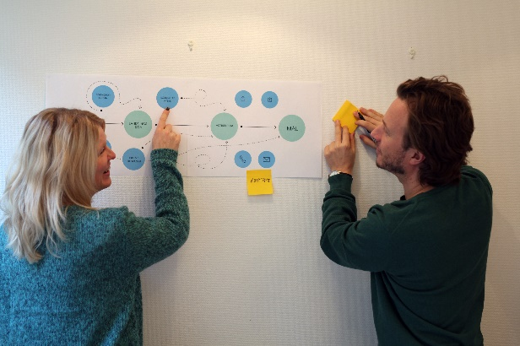
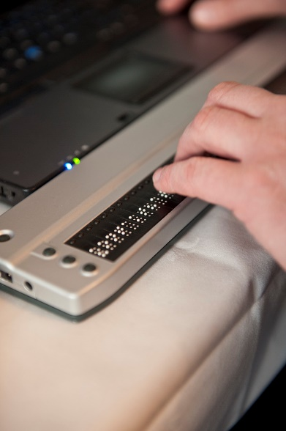
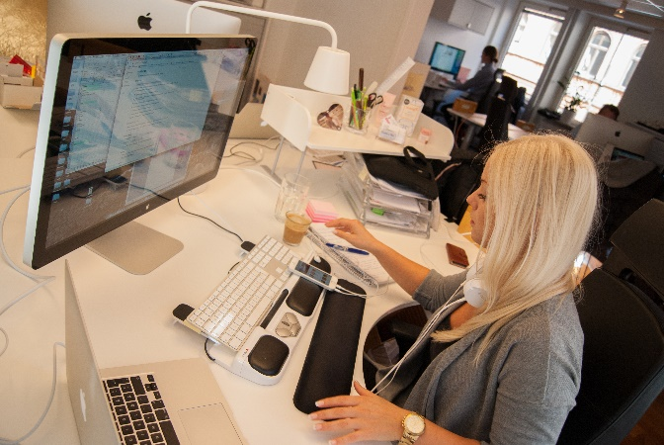

What we do
Consulting
  Development
  Analysis, testing and advice
  Training
Research and innovation
Government assignments
Collaborative projects
Standardization

Slide 4

Anti-Discrimination and Accessibility Act
Norway:
Public and private sectors
…focused on the general public
General functions
…including ICT
Universal design
…specific regulations on ICT and SST

Slide 5
When it comes to Self-Service Terminals, the regulation points to…

Slide 6
CEN/TS 15291:2006
- Identification Card Systems:
- Man-machine interface: Technical Specification:
Guidance on design of accessible card systems
ISO/TR 22411:2008
- Ergonomics data and guidelines for the application
of ISO/IEC Guide 71 to products and services to address
the needs of older persons and persons with disabilities
NS-EN 1332-1:2009
- Identification card systems
- Man-machine interface
- Part 1: Design principles for
the user interface
ISO 20282-1:2006
- Ease of operation of everyday products
-- Part 1: Context of use and user characteristics.
Self-Service Terminals
Web Content
Accessibility
Guidelines 2.0
Web Content
Accessibility
Guidelines 2.1
EN 1332-2:1998
- Identification Card Systems:
- Man-machine interface
Part 2: Dimensions and location
of a tactile identifier for ID-1 cards
EN 301549
ISO/TS 20282-2:2006
- Ease of operation of everyday products
-- Part 2: Test method
NS-EN 1332-3:2008
- Identification Card Systems:
- Man-machine interface
Part 3: Keypads
NS-EN 1332-5:2006
- Identification Card Systems:
- Man-machine interface
Part 5: Raised tactile symbols for differentiation of application on ID-1 cards
NS-EN ISO 9241-20:2009
- Ergonomics of human-system interaction
-- Part 20: Accessibility guidelines for
information/communication technology (ICT) equipment and services
NS-EN 1332-4:2007
- Identification Card Systems:
- Man-machine interface
Part 4: Coding of user requirements for people with special needs

Slide 7


Slide 8

You need a team of specialists to understand the requirements

Slide 9
The Agency for Public Management and eGovernment (Difi) in Norway gave Funka an assignment to create an easy-to-use guide for the accessible placement of self-service terminals

Slide 10
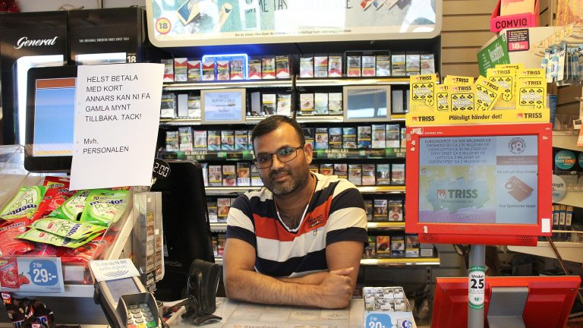

Slide 11

What we found
A massive amount of requirements in the different standards
Requirements that were hard to interpret
Requirements that contradicted each other
Important issues were not covered in the standards

Slide 12
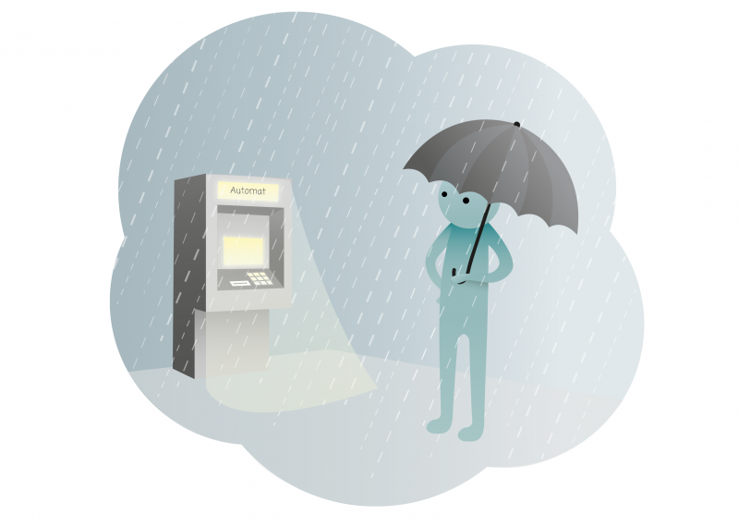
What we did
Filtered out the relevant requirements
Removed contradictory requirements
Grouped requirements together, e.g.:
  Finding the terminal
  Making your way to the terminal
  Area in front of the terminal and the surrounding environment
  Using the terminal
Produced understandable texts, illustrations
and an introductory video
Both minimum requirements and recommendations
Link to the guide (in Norwegian)

Slide 13
What is needed
Harmonization of the requirements
Updates to some of the requirements
Simplified versions of the relevant standards
More step-by-step guides
A tool where different target groups can filter the requirements

Slide 14
If we want the world to use standards, they need to be accessible and understandable to everyone affected by them

Slide 15
There is no such thing as an average user
andreas.cederbom@funka.com
Twitter: @cederbomarn

